Slide 1
BBM 102 – Introduction to Programming II Spring 2018
Inheritance

Slide 2
Today
Inheritance
Notion of subclasses and superclasses
protected members
UML Class Diagrams for inheritance

Slide 3
Inheritance
A form of software reuse in which a new class is created by obtaining an existing class’s members and decorating them with new or modified capabilities.
Can save time during program development by basing new classes on existing proven and debugged high-quality software.
Increases the likelihood that a system will be implemented and maintained effectively.

Slide 4
Inheritance
When creating a class, rather than declaring completely new members, you can designate that the new class should inherit the members of an existing class.
Existing class is the superclass
New class is the subclass
The subclass exhibits the behaviors of its superclass and can add behaviors that are specific to the subclass.
This is why inheritance is sometimes referred to as specialization.
A subclass is more specific than its superclass and represents a more specialized group of objects.

Slide 5
Inheritance
The direct superclass is the superclass from which the subclass explicitly inherits.
An indirect superclass is any class above the direct superclass in the class hierarchy.
The Java class hierarchy begins with class Object (in package java.lang)
Every class in Java directly or indirectly extends (or “inherits from”) Object.
Java supports only single inheritance, in which each class is derived from exactly one direct superclass.

Slide 6
Advantages of inheritance
When a class inherits from another class, there are three benefits:
(1) You can reuse the methods and data of the
existing class
(2) You can extend the existing class by adding new data and new methods
(3) You can modify the existing class by overriding its methods with your own implementations

Slide 7
Relationships between classes
We distinguish between the is-a relationship and the has-a relationship
Is-a represents inheritance
In an is-a relationship, an object of a subclass can also be treated as an object of its superclass
Has-a represents composition
In a has-a relationship, an object contains as members references to other objects
© Copyright 1992-2012 by Pearson Education, Inc. All Rights Reserved.

Slide 8
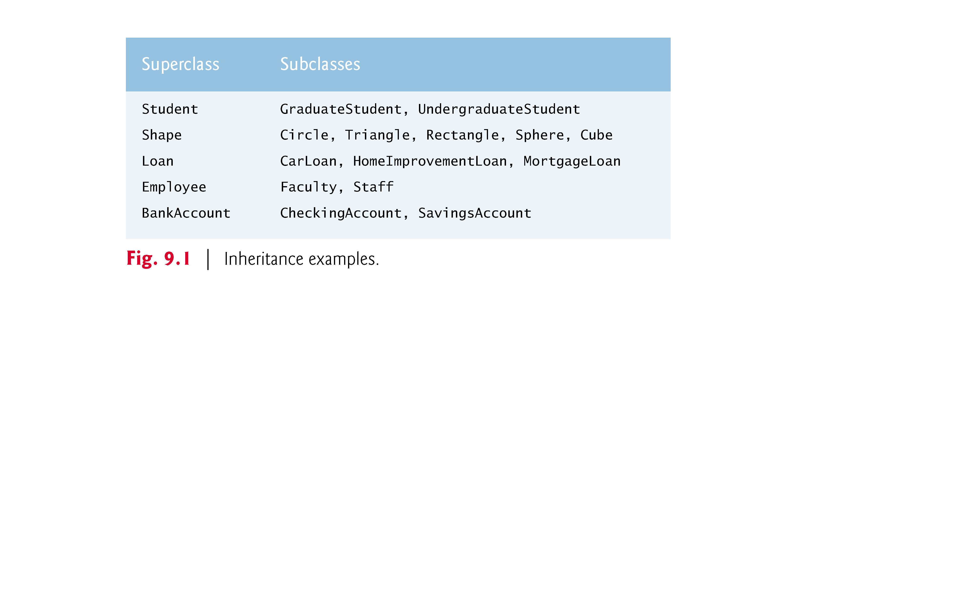
Superclasses and Subclasses
Superclasses tend to be “more general” and subclasses “more specific.”

Slide 9
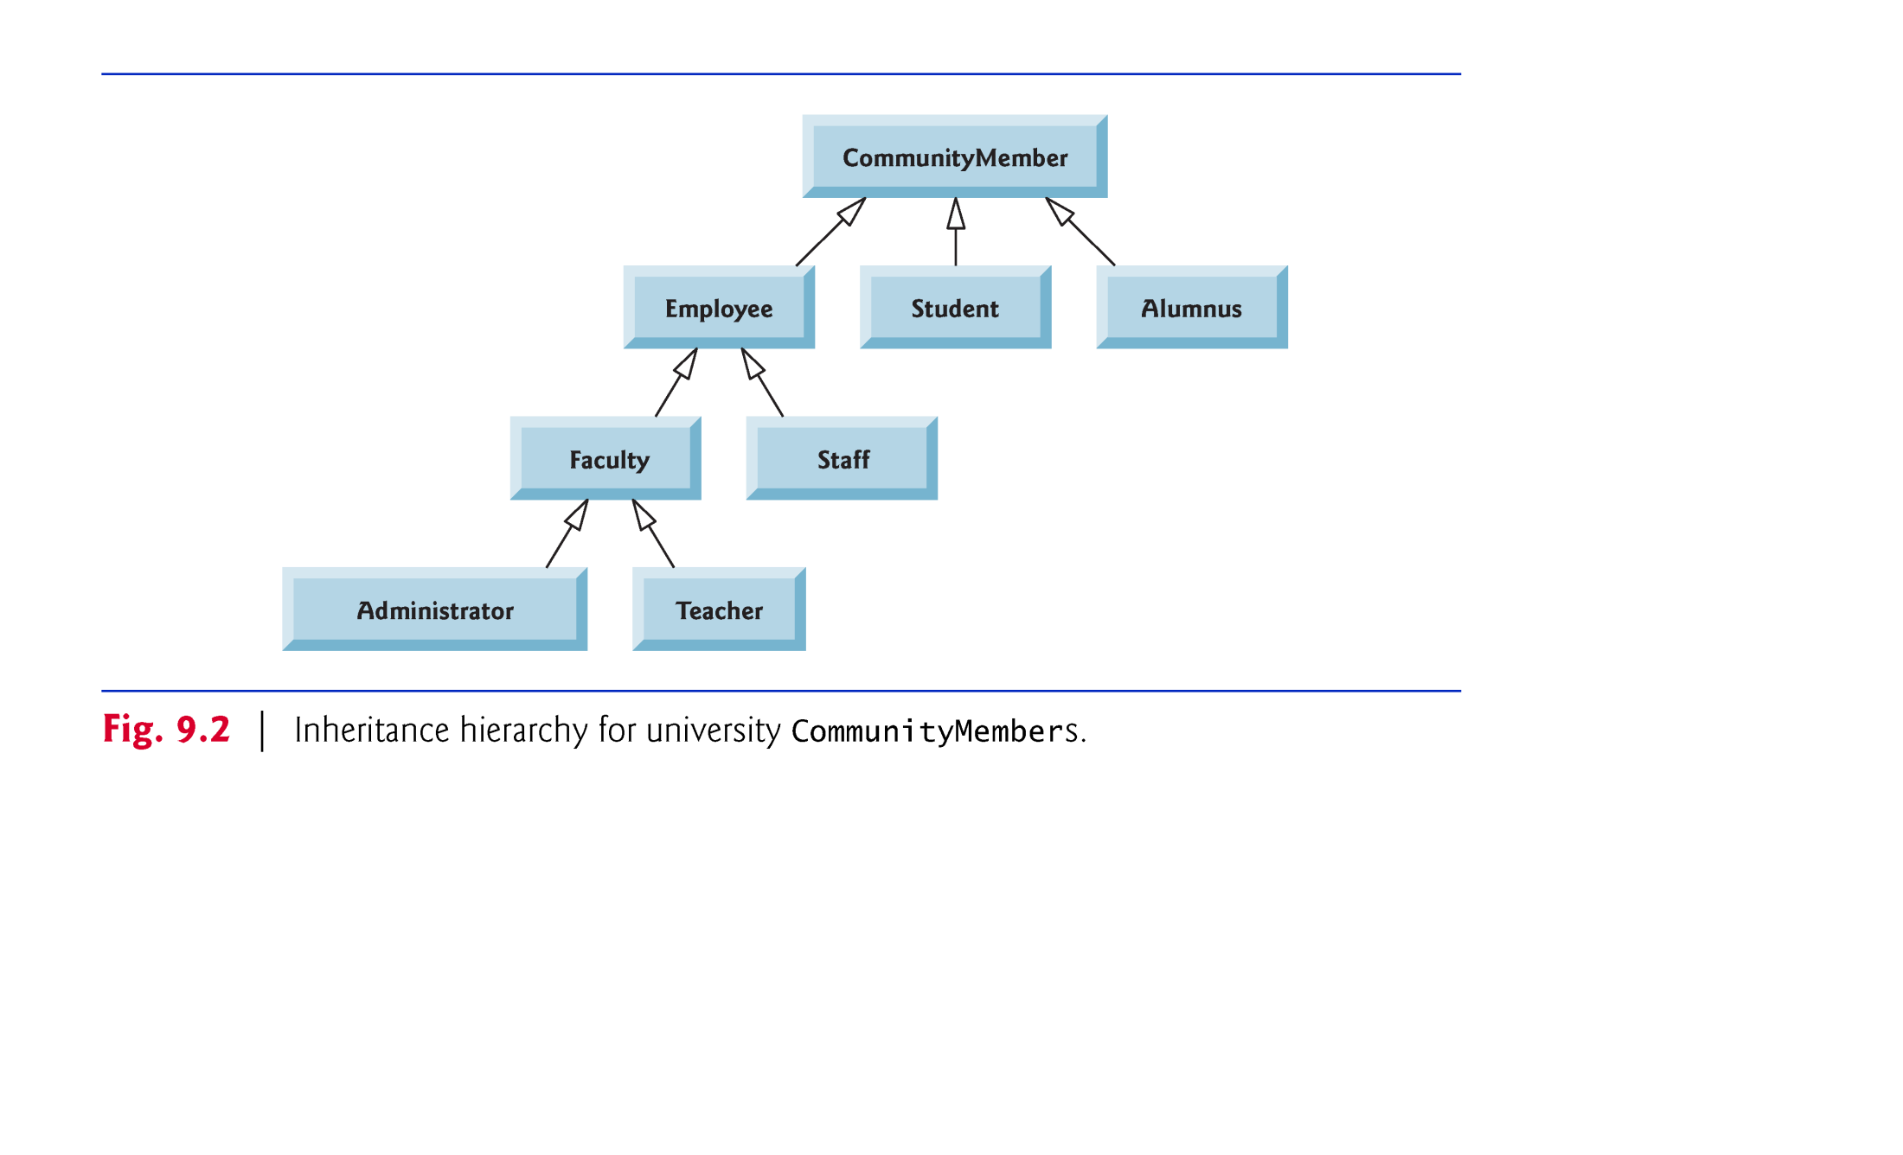
A sample university community class hierarchy
Also called an inheritance hierarchy.
Each arrow in the hierarchy represents an is-a relationship.
Follow the arrows upward in the class hierarchy
“an Employee is a CommunityMember”
“a Teacher is a Faculty member.”
© Copyright 1992-2012 by Pearson Education, Inc. All Rights Reserved.

Slide 10
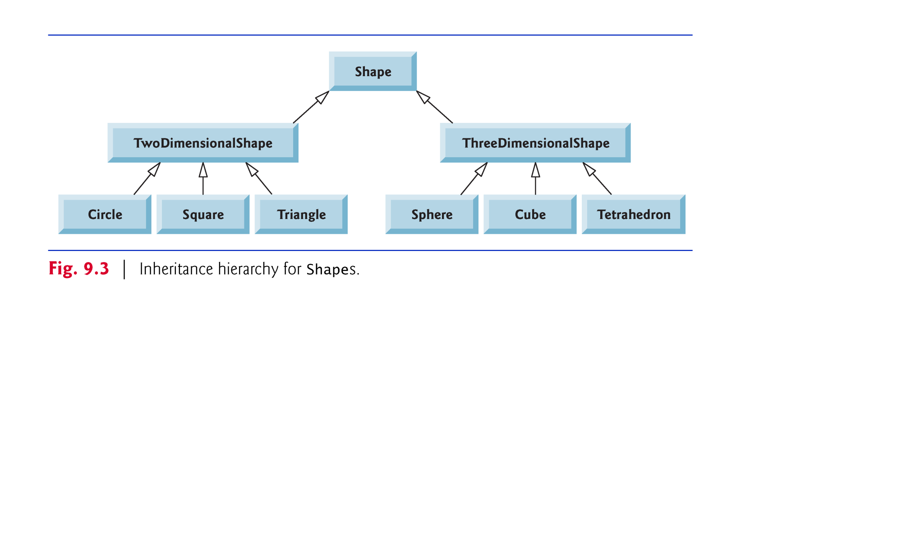
Superclasses and Subclasses (Cont.)
Below is Shape inheritance hierarchy.
Follow the arrows from the bottom of the diagram to the topmost superclass to identify several is-a relationships.
A Triangle is a TwoDimensionalShape and is a Shape
A Sphere is a ThreeDimensionalShape and is a Shape.

Slide 11
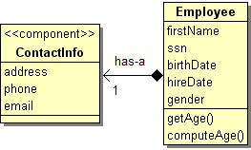
Superclasses and Subclasses (Cont.)
Not every class relationship is an inheritance relationship.
Has-a relationship
Create classes by composition of existing classes.
Example: Given the classes Employee, BirthDate and ContactInfo, it’s improper to say that an Employee is a BirthDate or that an Employee is a ContactInfo.
However, an Employee has a BirthDate, and an Employee has a ContactInfo.

Slide 12
protected Members
A class’s public members are accessible wherever the program has a reference to an object of that class or one of its subclasses.
A class’s private members are accessible only within the class itself.
protected access is an intermediate level of access between public and private.
A superclass’s protected members can be accessed by members of that superclass, by members of its subclasses and by members of other classes in the same package.
protected members also have package access.

Slide 13
protected Members (Cont.)
A superclass’s private members are hidden in its subclasses
They can be accessed only through the public or protected methods inherited from the superclass
Subclass methods can refer to public and protected members inherited from the superclass simply by using the member names.
When a subclass method overrides an inherited superclass method, the superclass method can be accessed from the subclass by preceding the superclass method name with keyword super and a dot (.) separator.

Slide 14
Case Study: Commission Employees
Inheritance hierarchy containing types of employees in a company’s payroll application
Commission employees are paid a percentage of their sales
Base-salaried commission employees receive a base salary plus a percentage of their sales.

Slide 15
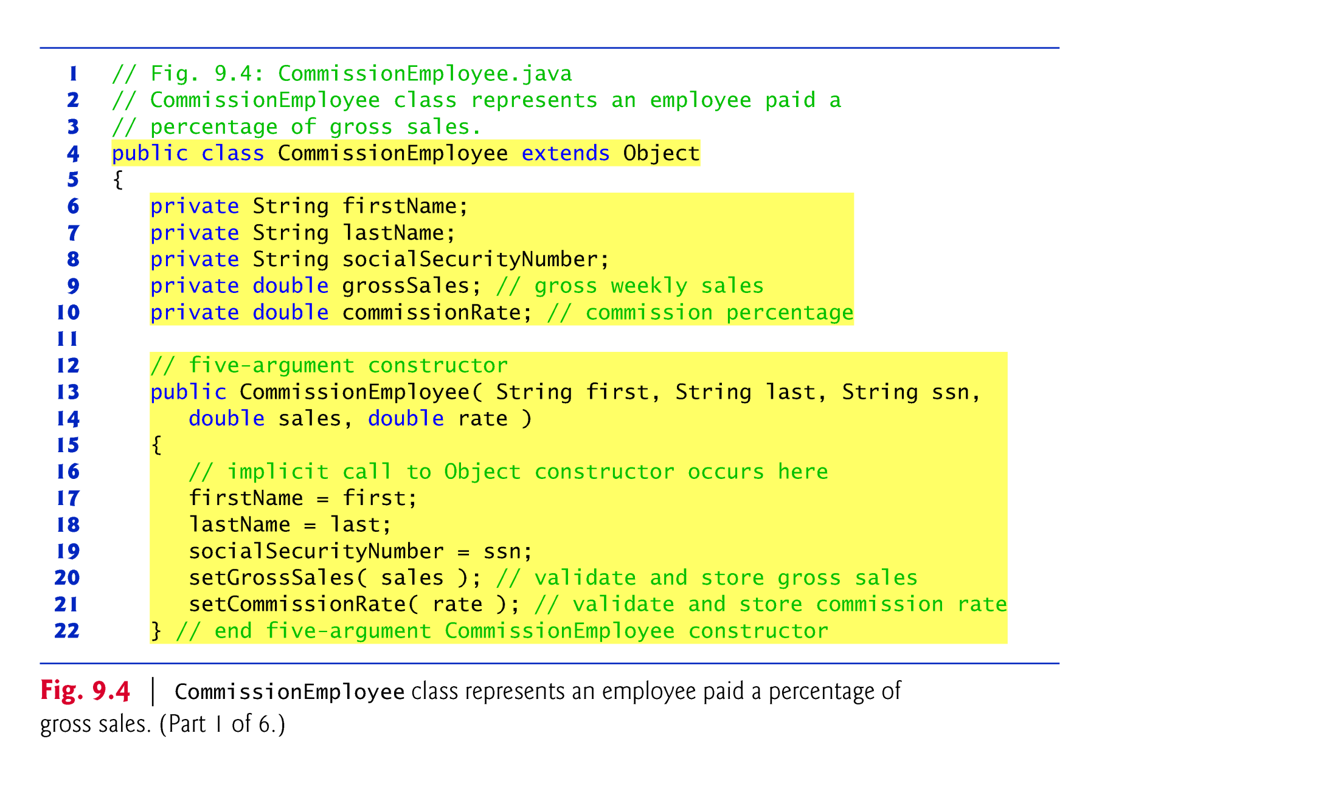
Creating and Using a CommissionEmployee Class
Class CommissionEmployee extends class Object (from package java.lang).
CommissionEmployee inherits Object’s methods.
If you don’t explicitly specify which class a new class extends, the class extends Object implicitly.

Slide 16
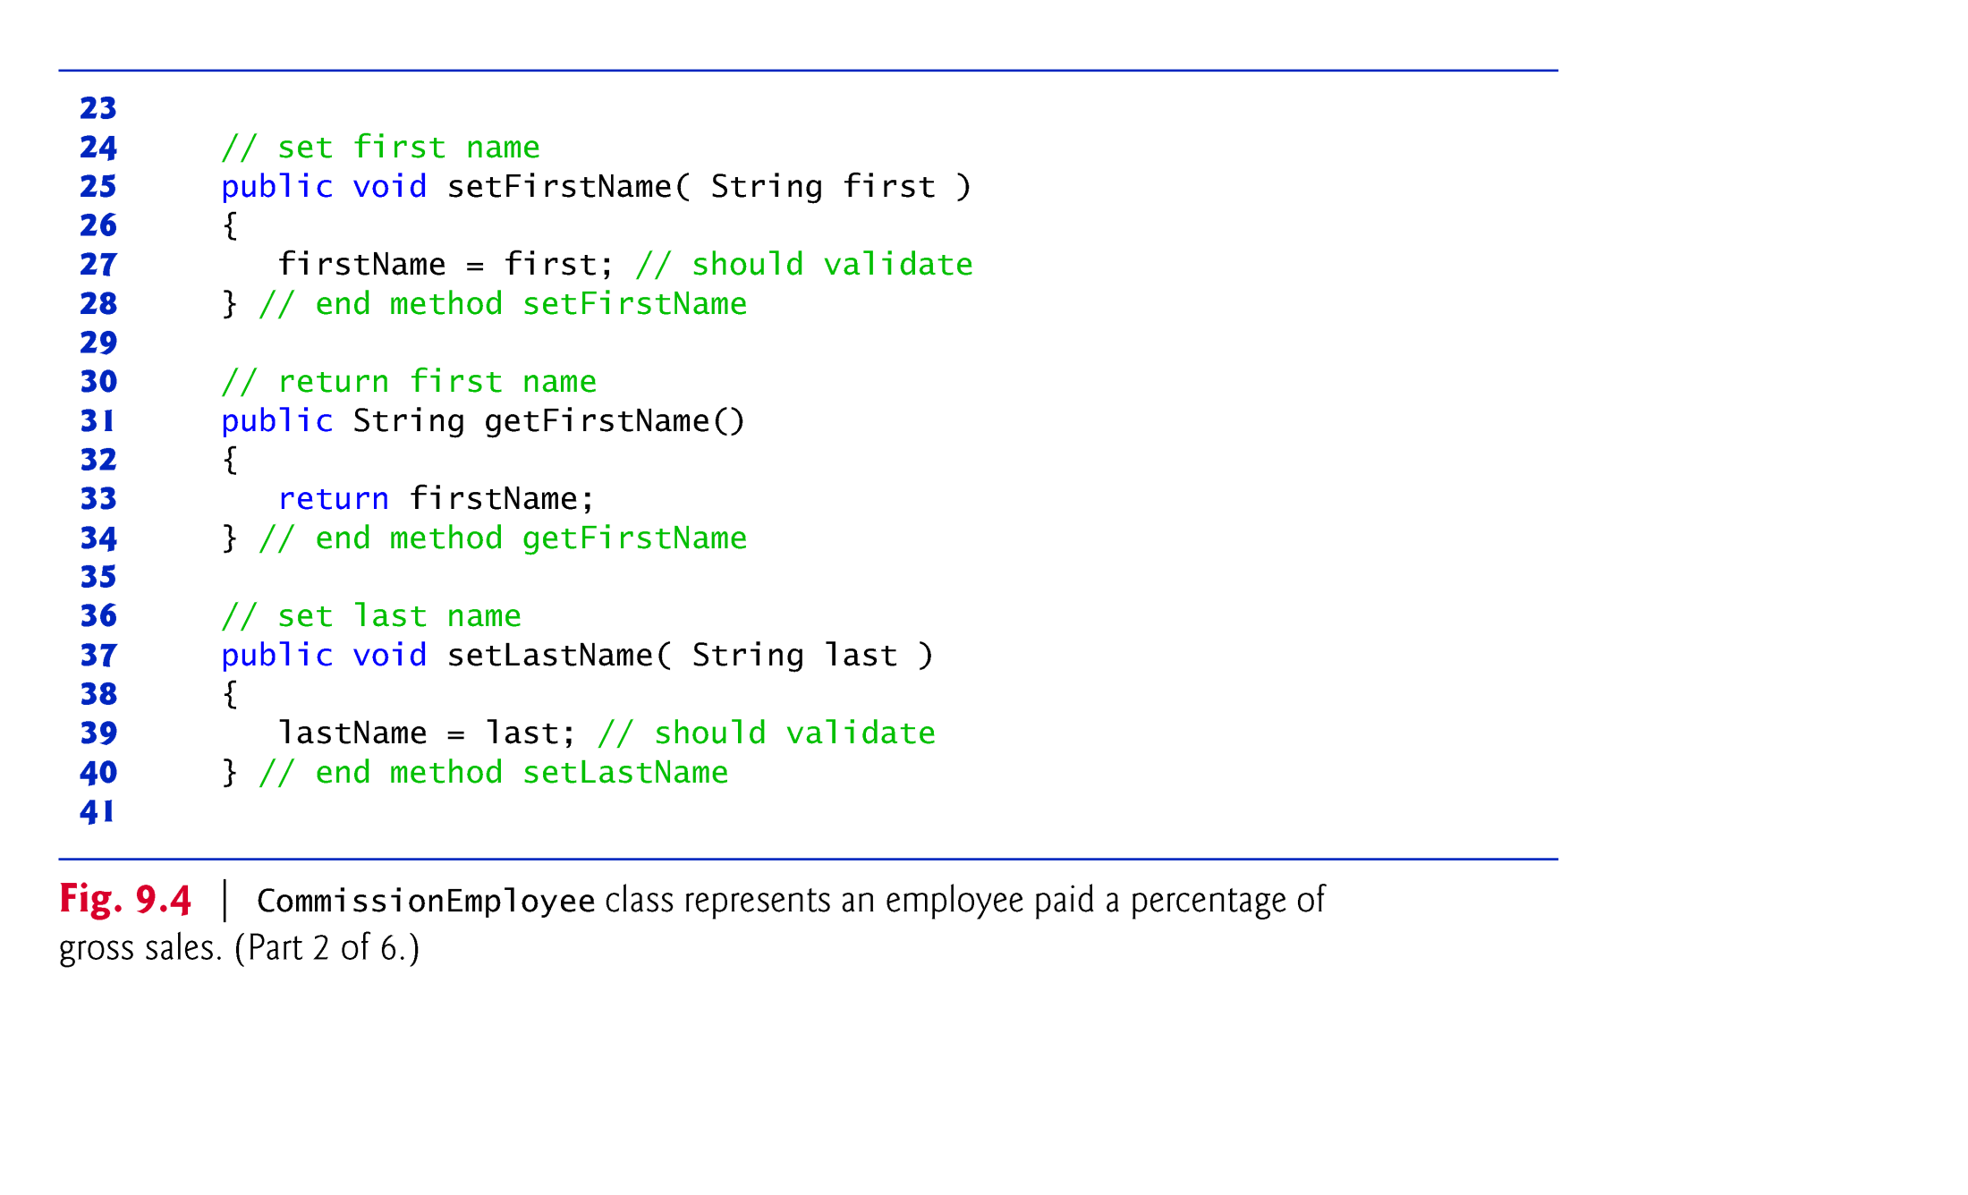

Slide 17
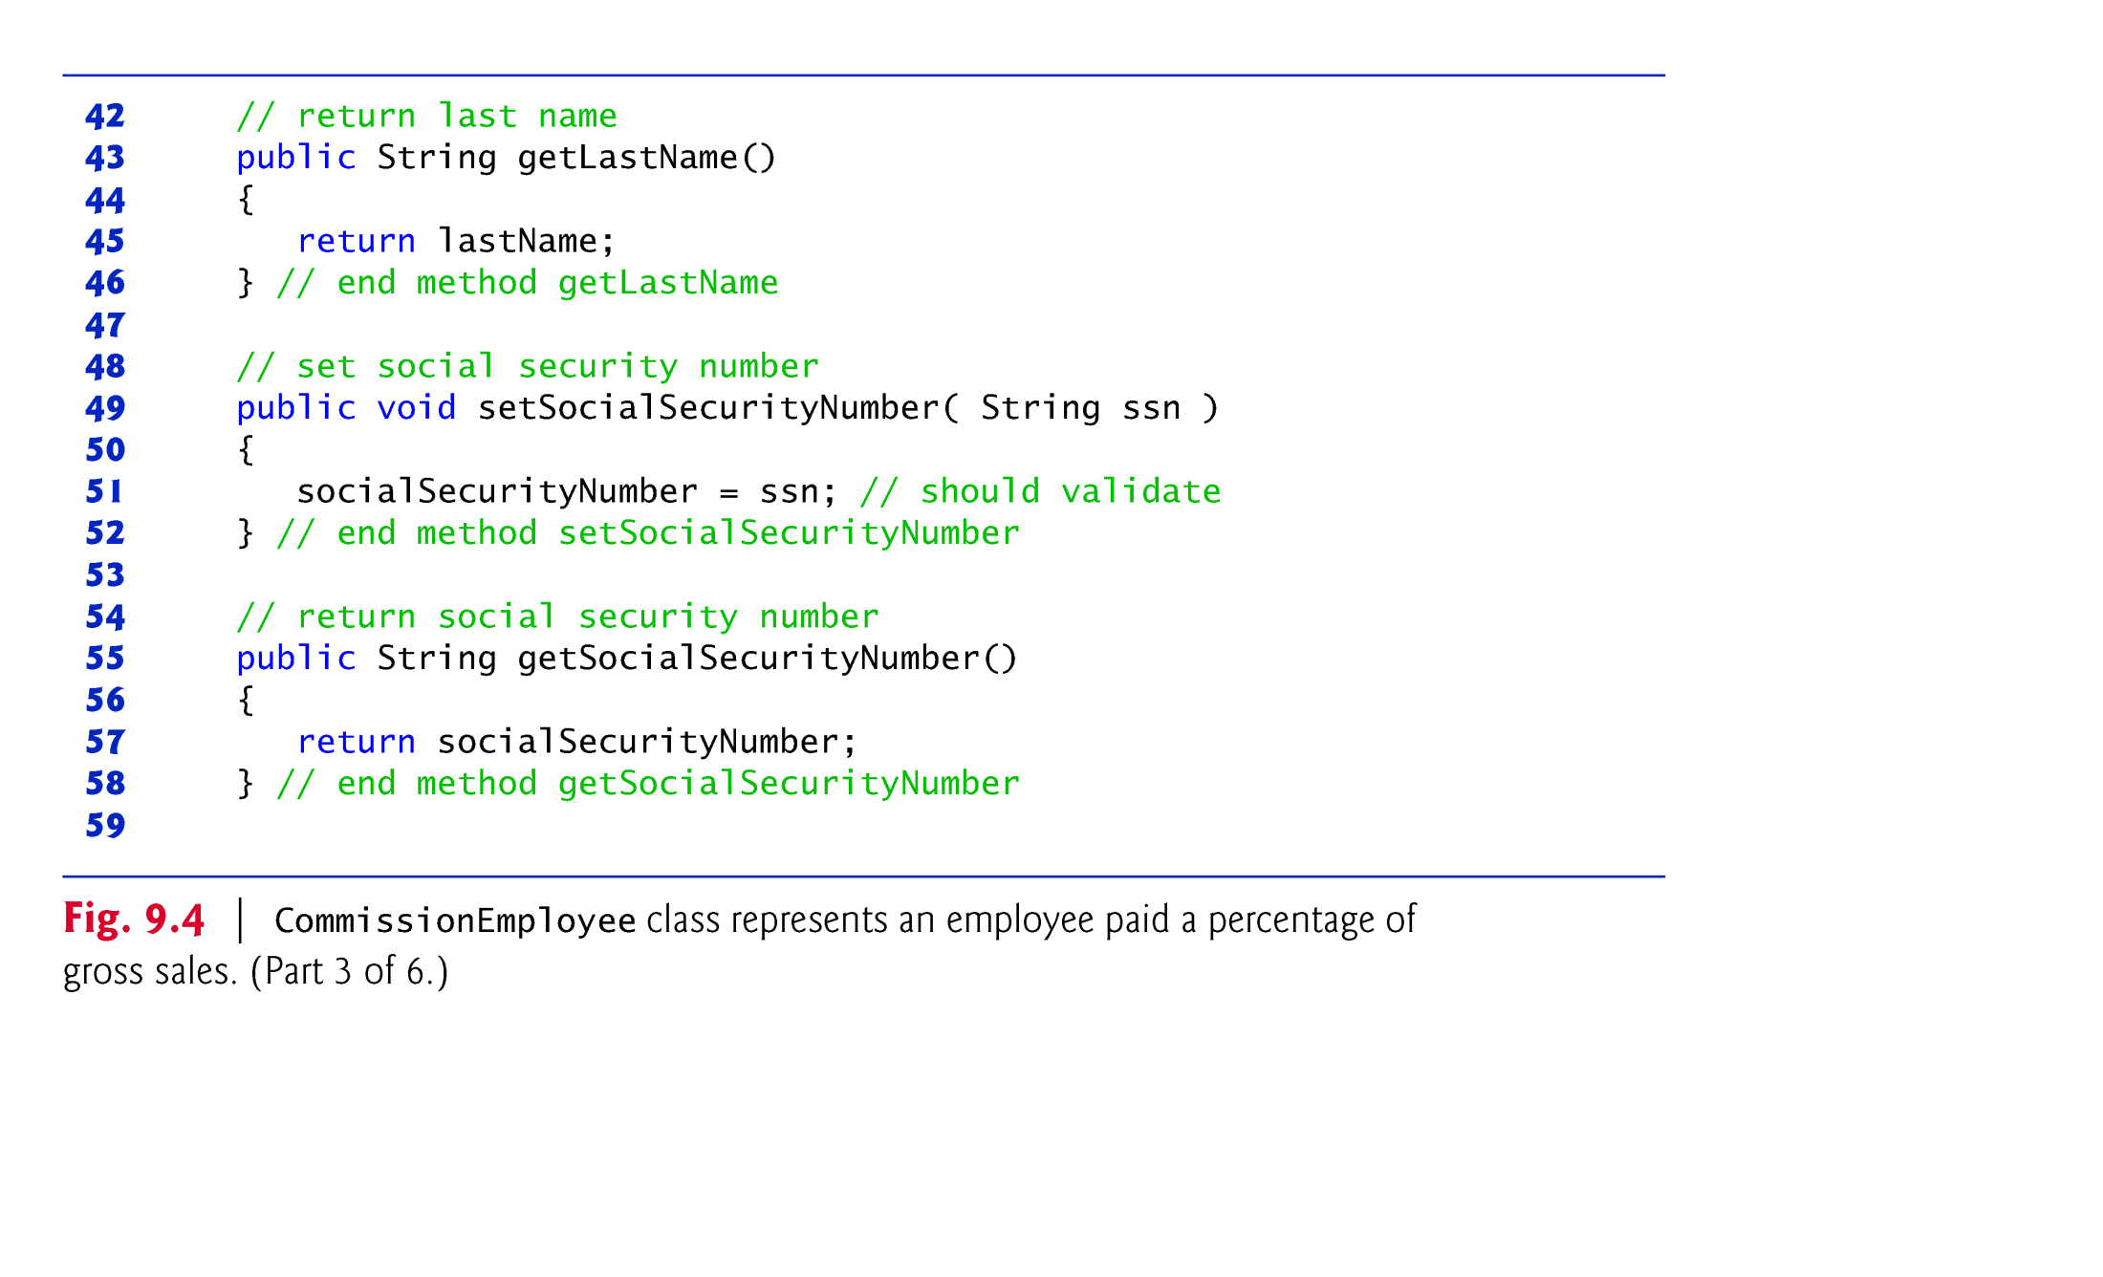

Slide 18
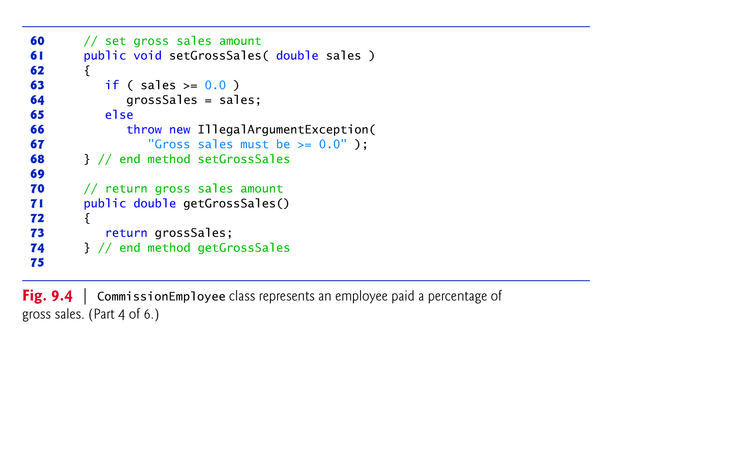

Slide 19
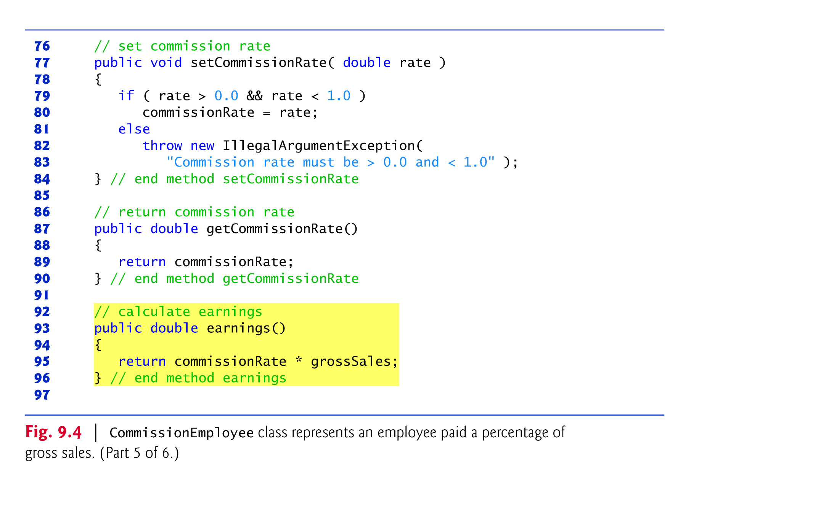

Slide 20
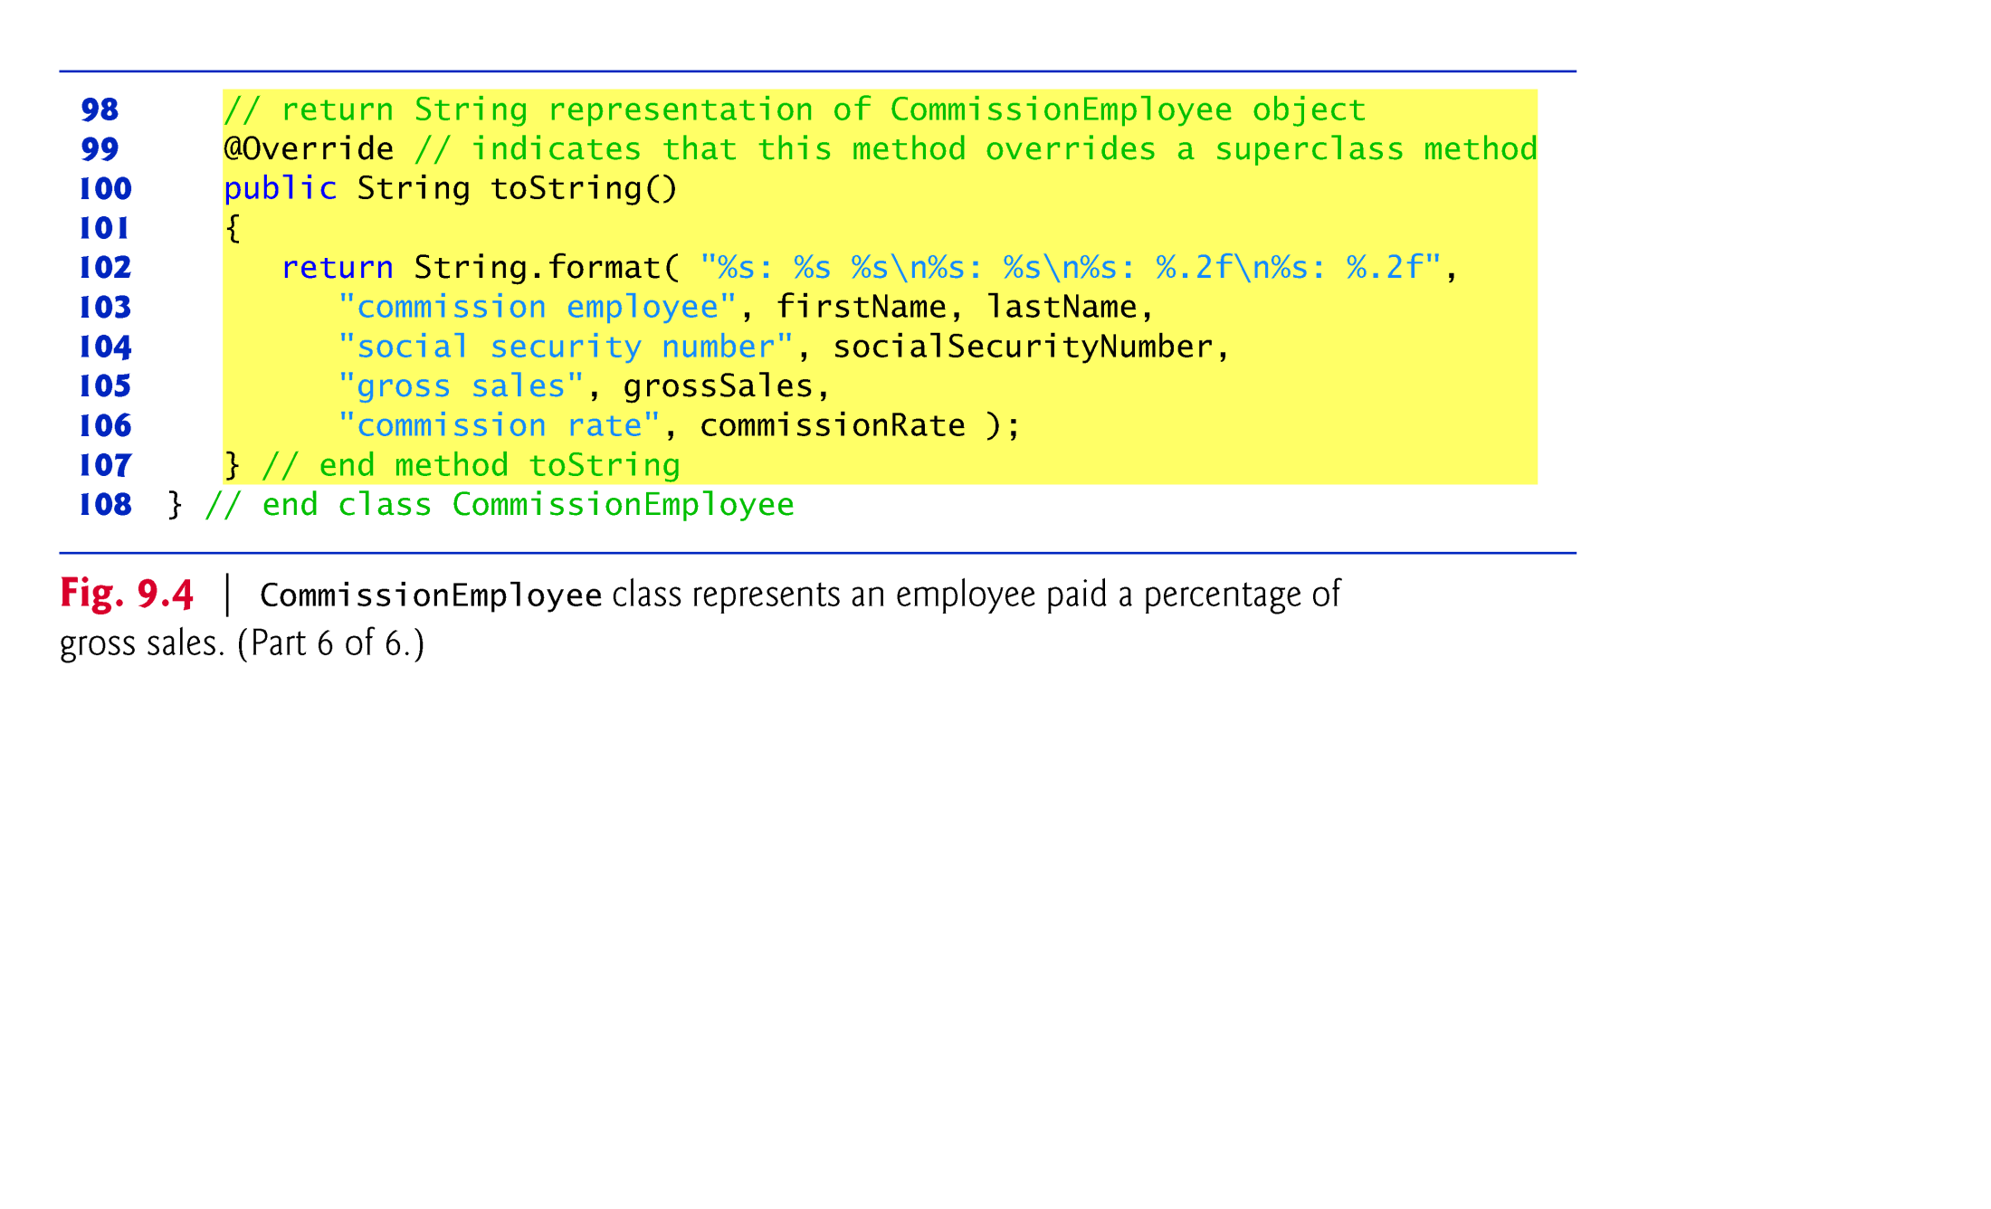

Slide 21
Creating and Using a CommissionEmployee Class (Cont.)
Constructors are not inherited.
The first task of a subclass constructor is to call its direct superclass’s constructor explicitly or implicitly
Ensures that the instance variables inherited from the superclass are initialized properly.
If the code does not include an explicit call to the superclass constructor, Java implicitly calls the superclass’s default or no-argument constructor.
A class’s default constructor calls the superclass’s default or no-argument constructor.

Slide 22
Creating and Using a CommissionEmployee Class (Cont.)
toString is one of the methods that every class inherits directly or indirectly from class Object.
Returns a String representing an object.
Called implicitly whenever an object must be converted to a String representation.
Class Object’s toString method returns a String that includes the name of the object’s class.
This is primarily a placeholder that can be overridden by a subclass to specify an appropriate String representation.

Slide 23
Creating and Using a CommissionEmployee Class (Cont.)
To override a superclass method, a subclass must declare a method with the same signature as the superclass method
@Override annotation
Indicates that a method should override a superclass method with the same signature.
It helps the compiler to check the method if available for overriding.

Slide 24
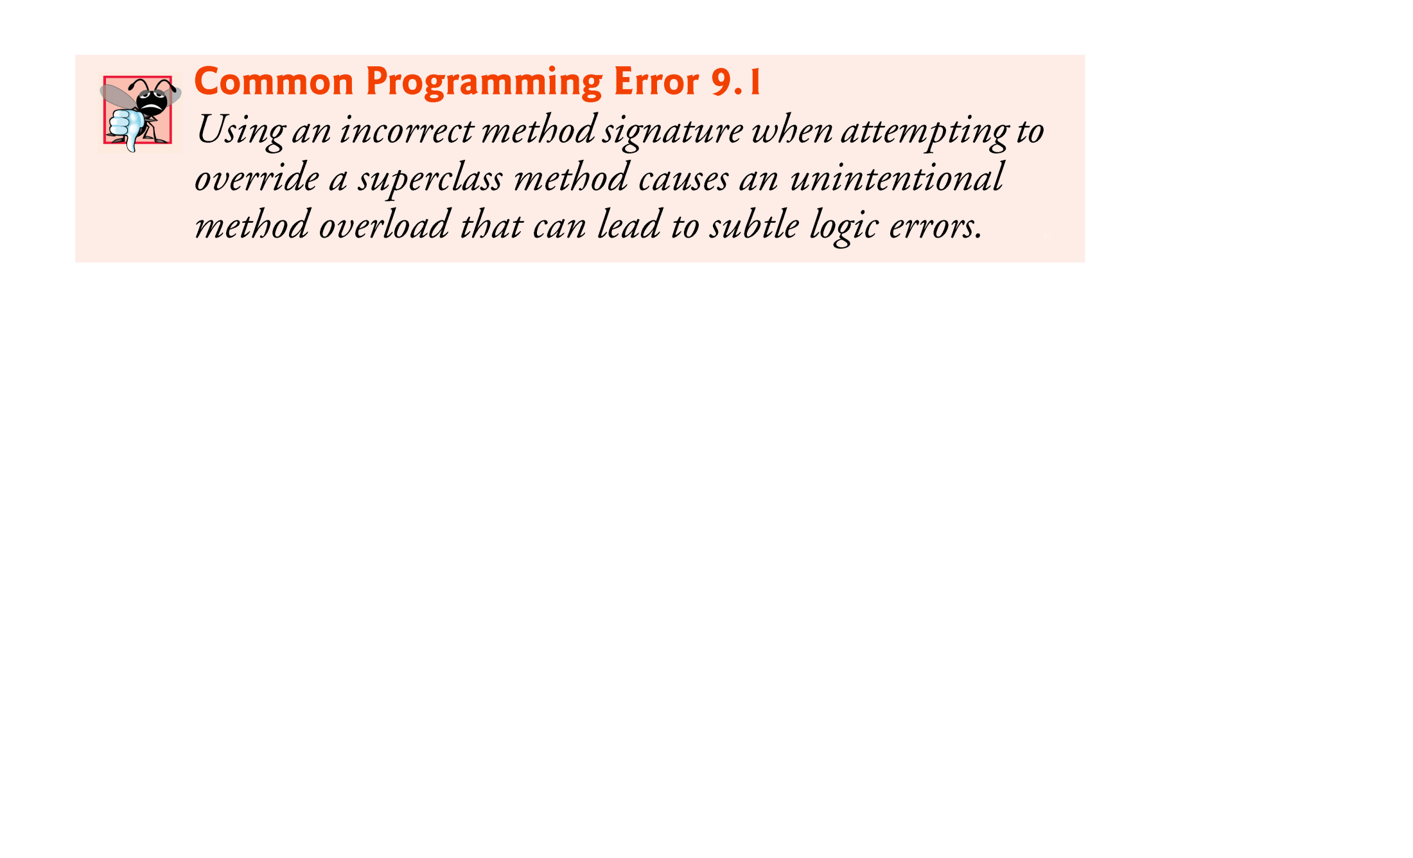
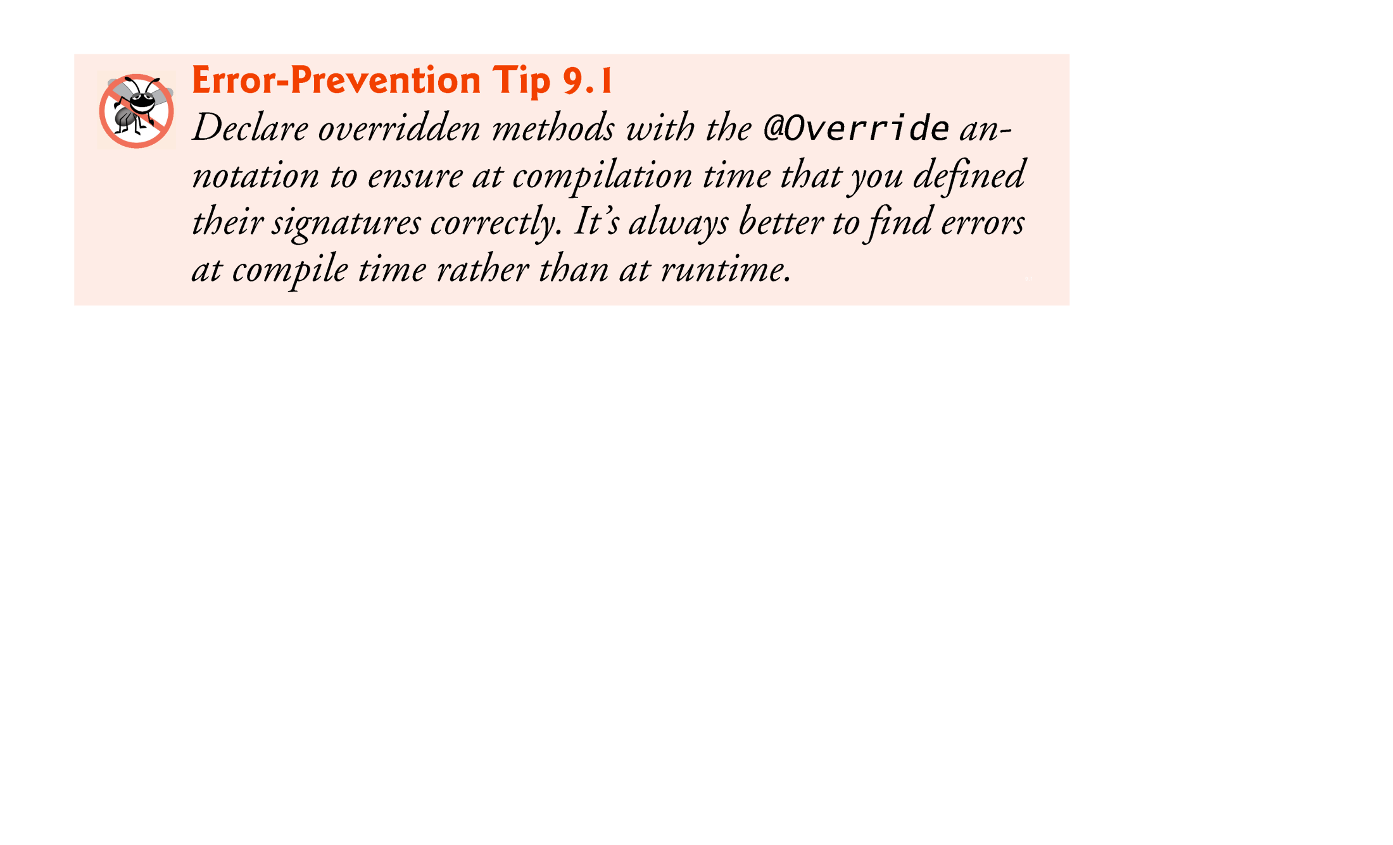

Slide 25
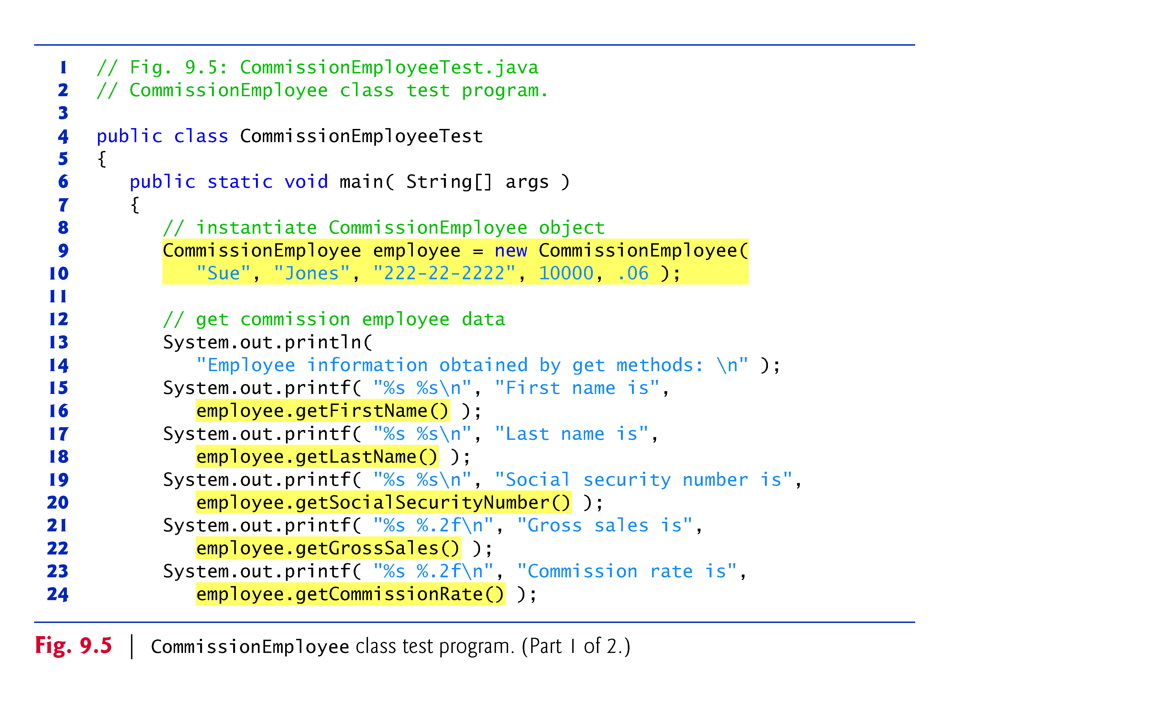

Slide 26
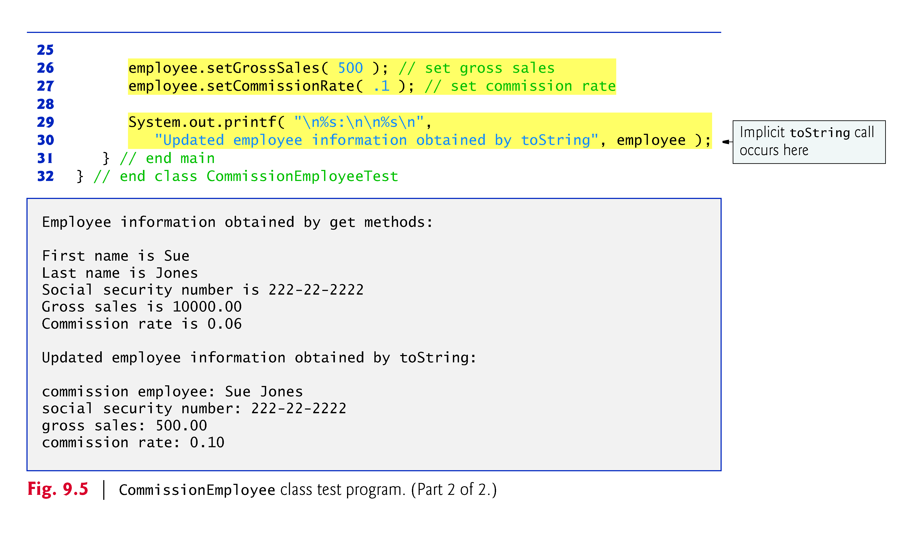

Slide 27
Case Study Part 2: Creating and Using a BasePlus-CommissionEmployee Class
Class BasePlusCommissionEmployee contains a first name, last name, social security number, gross sales amount, commission rate and base salary.
All but the base salary are in common with class CommissionEmployee.
Class BasePlusCommissionEmployee’s public services include a constructor, and methods earnings, toString and get and set for each instance variable
Most of these are in common with class CommissionEmployee.

Slide 28
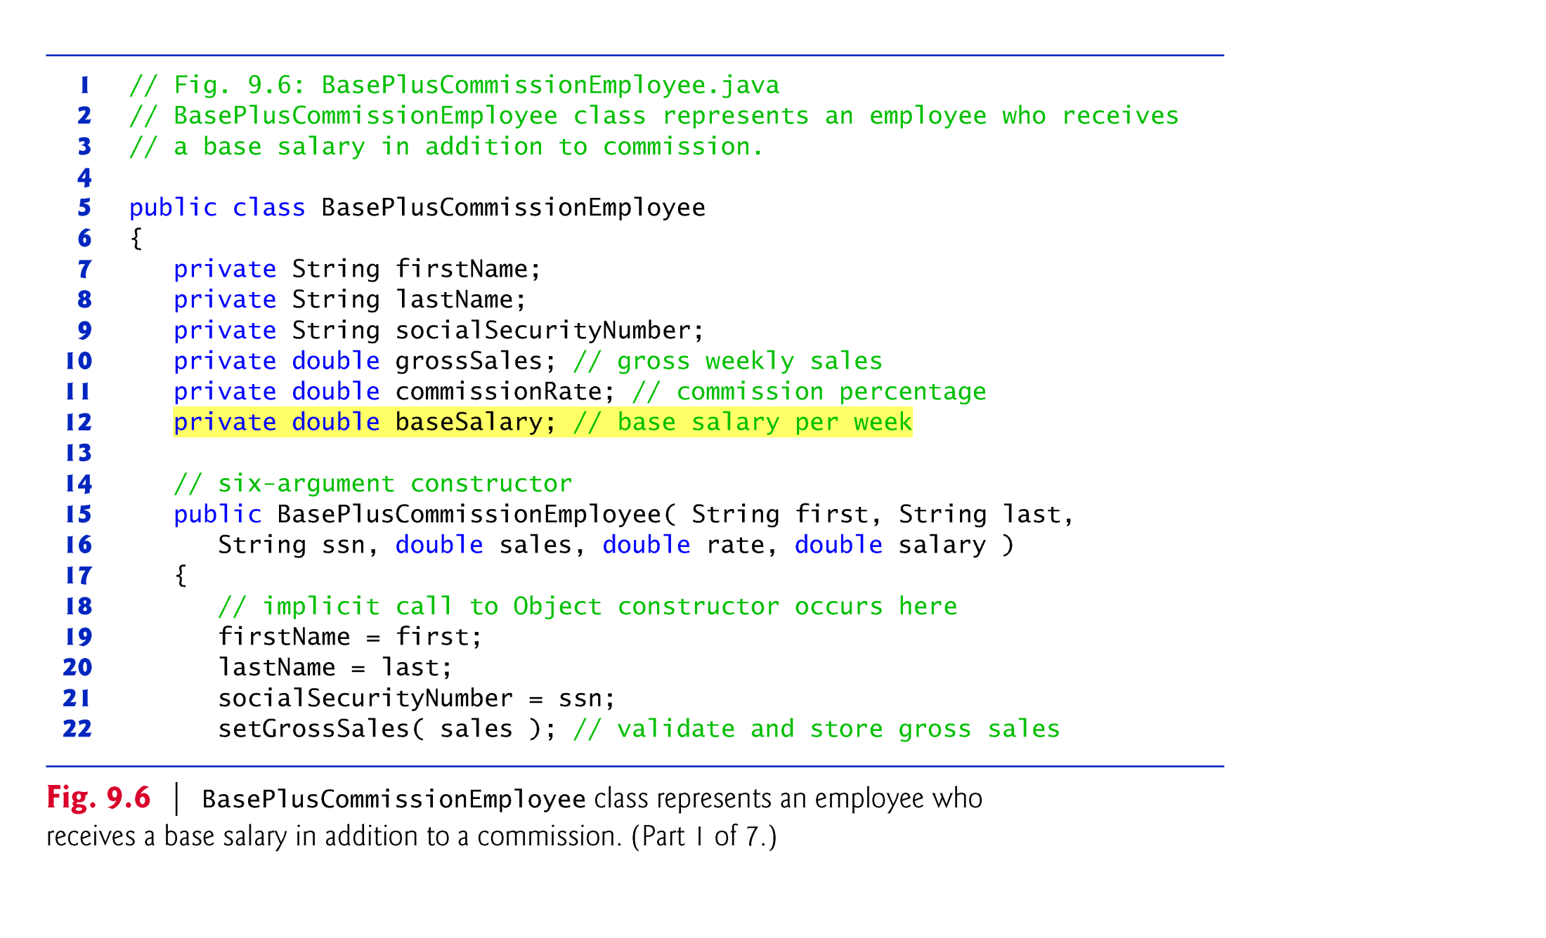
Class BasePlusCommissionEmployee does not specify “extends Object”, Implicitly extends Object.
BasePlusCommissionEmployee’s constructor invokes class Object’s default constructor implicitly.

Slide 29
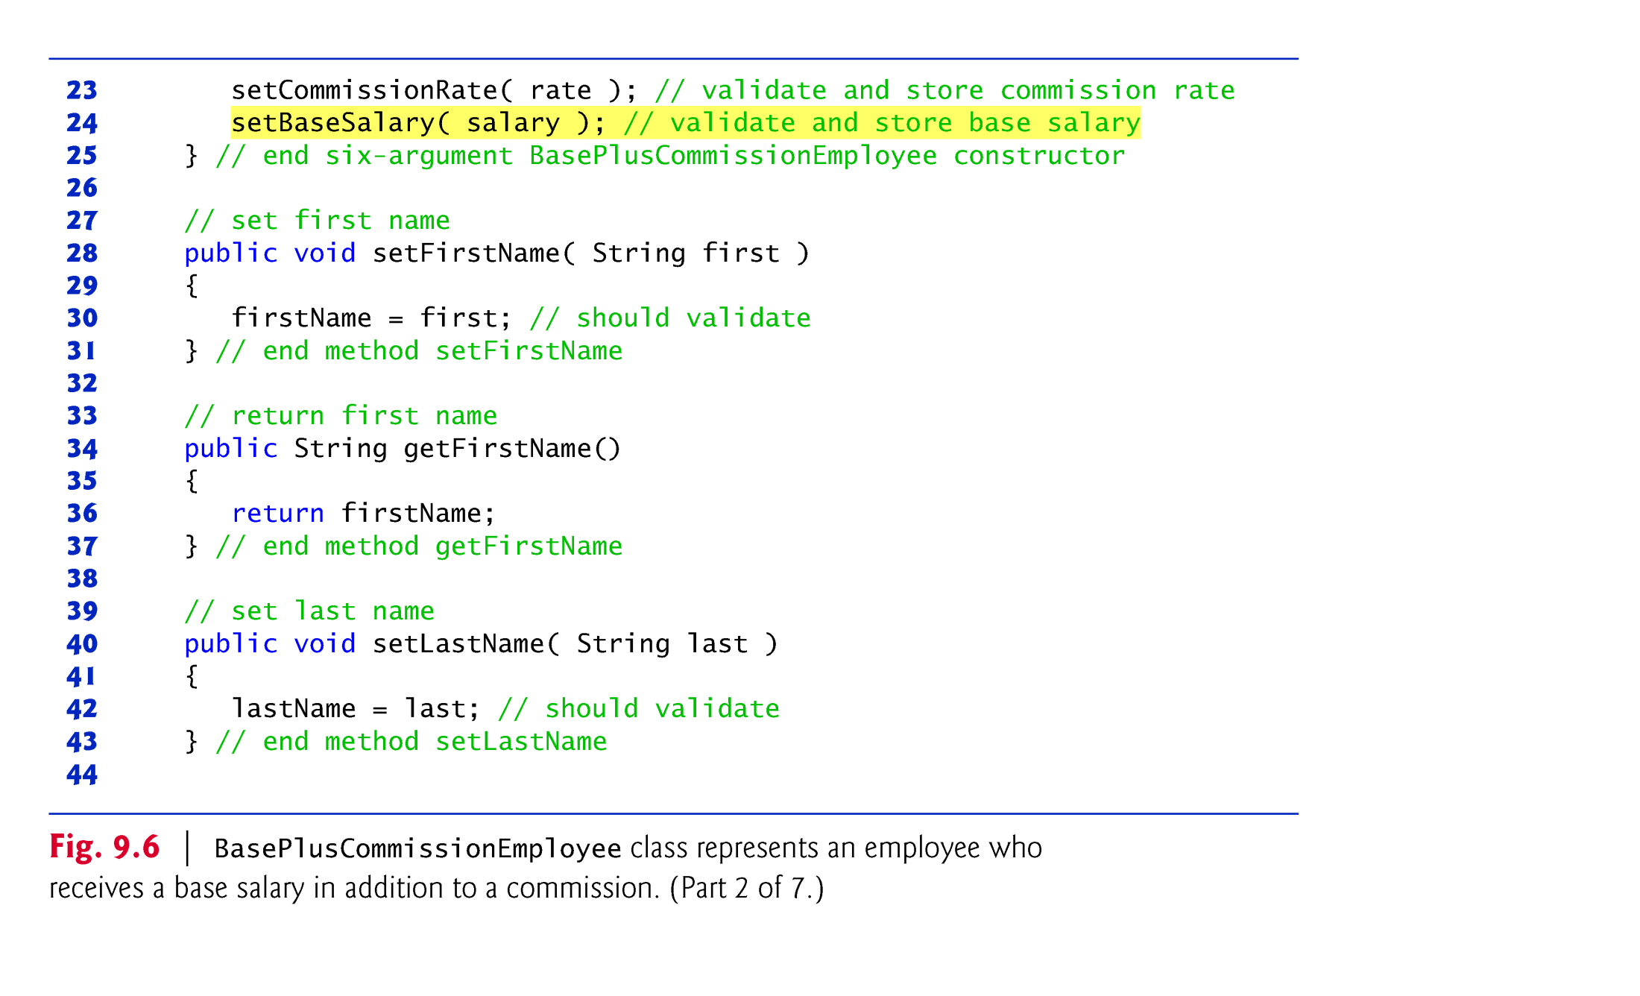

Slide 30
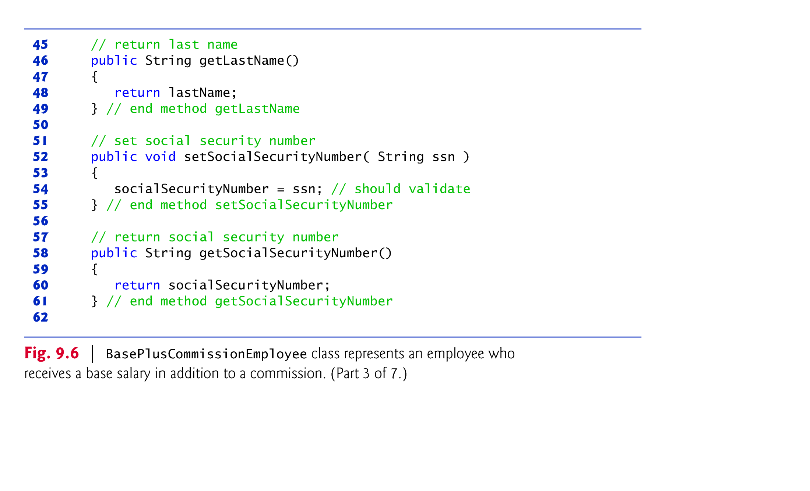

Slide 31
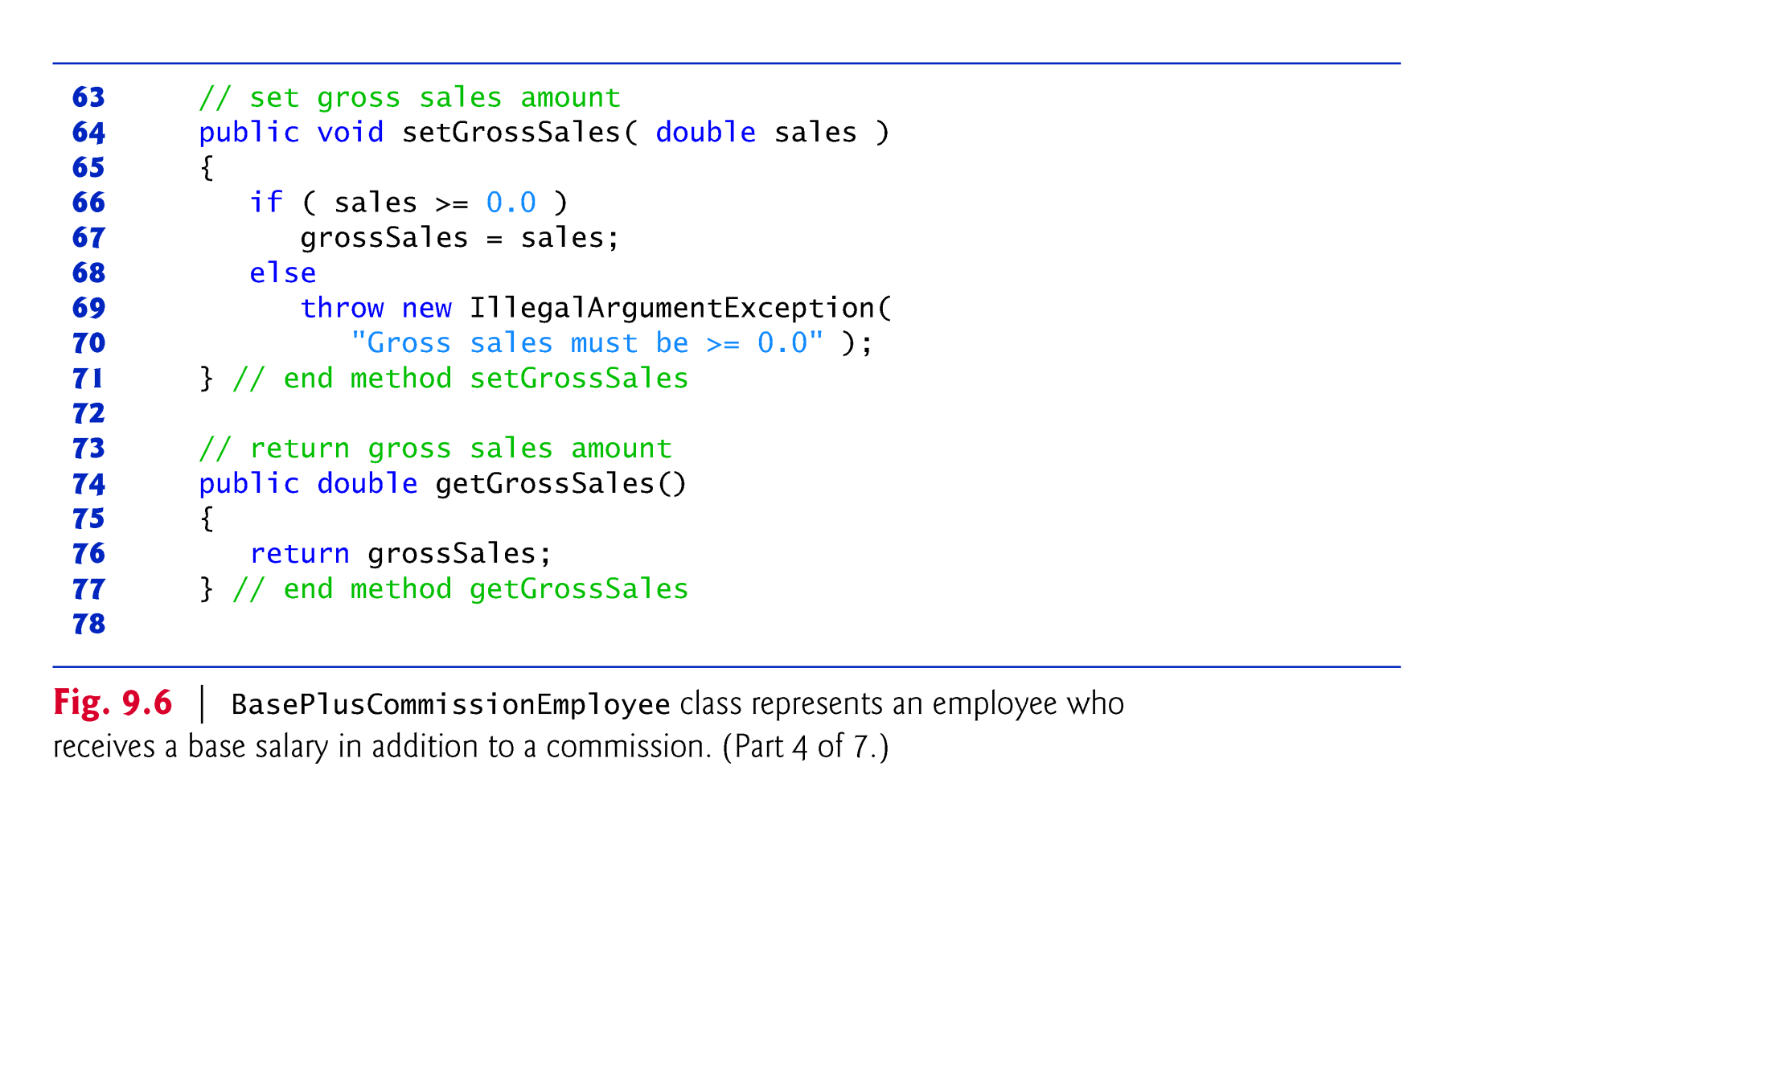

Slide 32
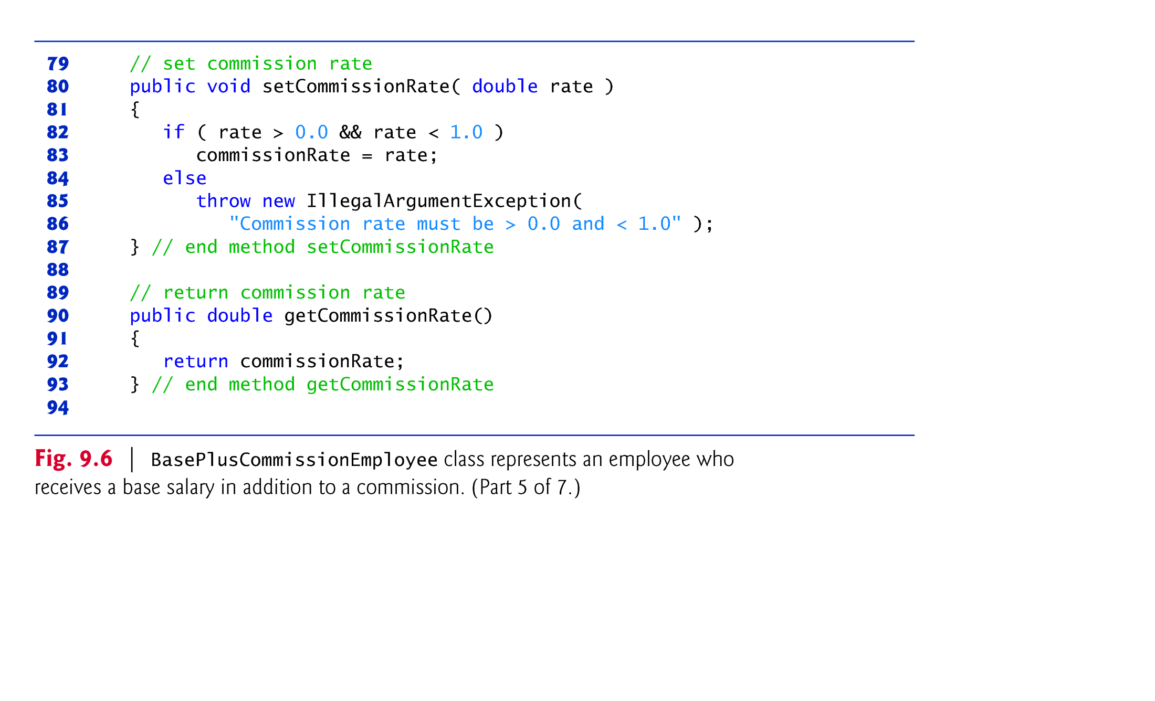

Slide 33
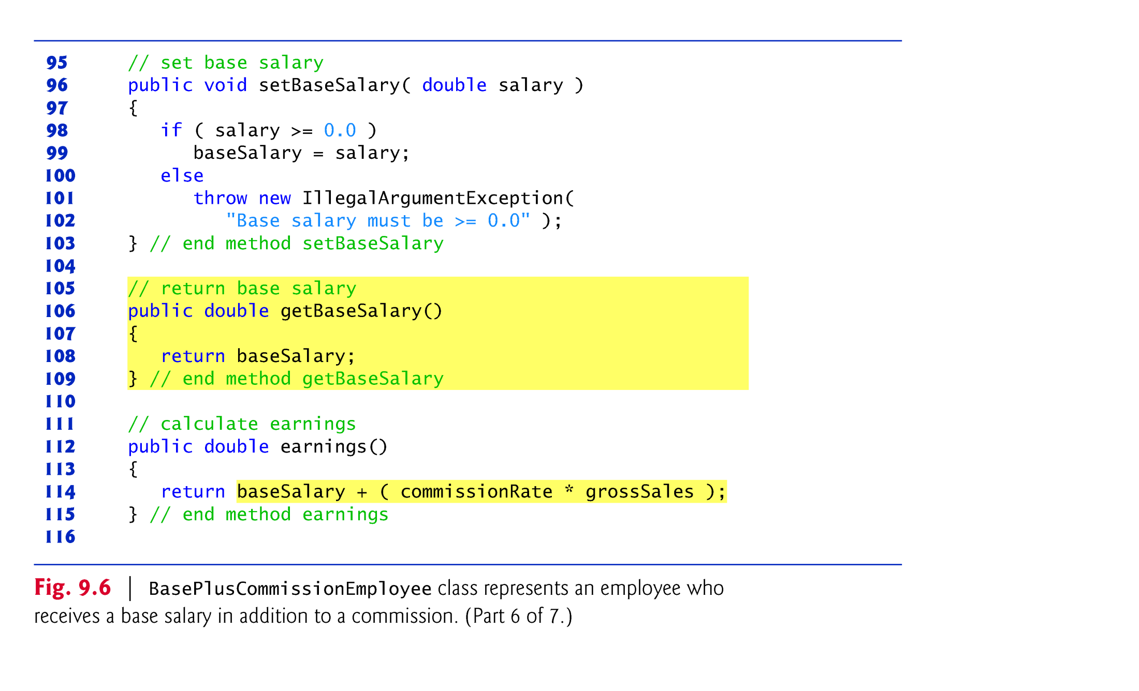

Slide 34
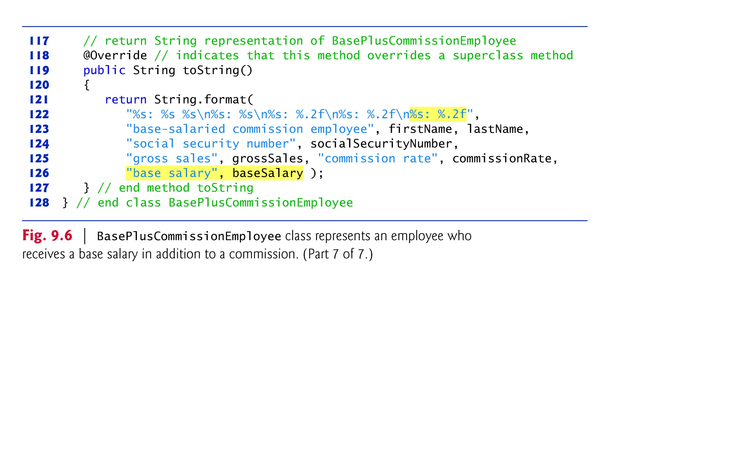

Slide 35
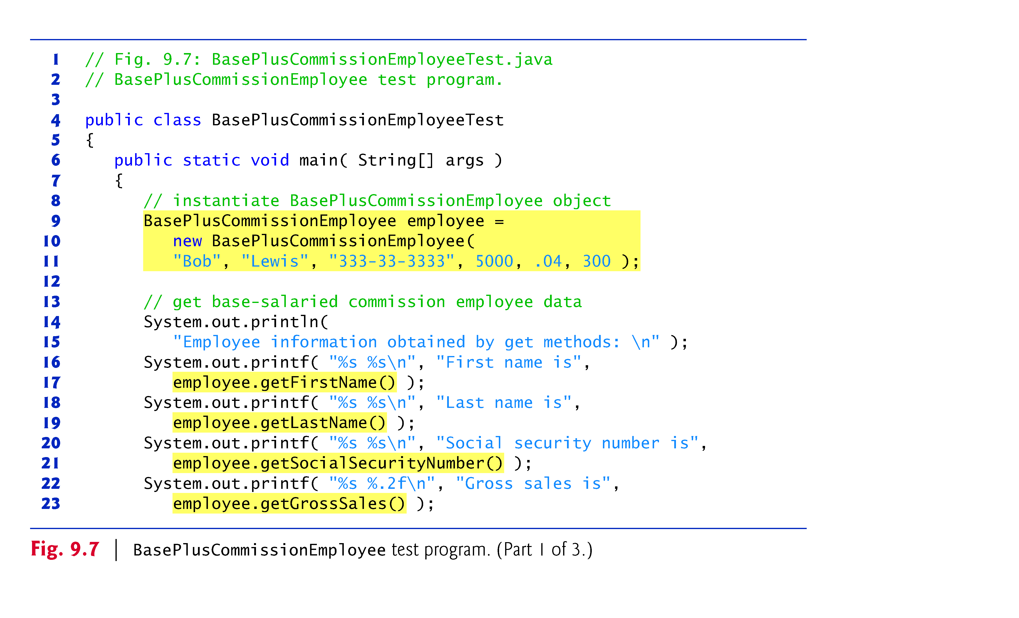

Slide 36
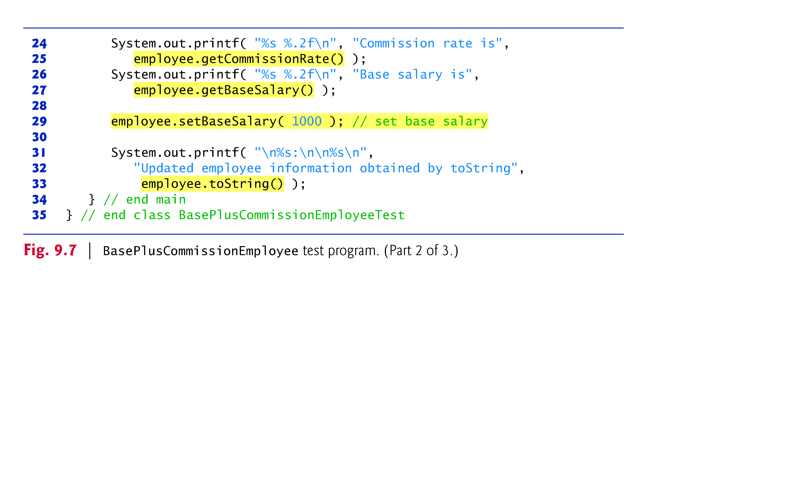

Slide 37
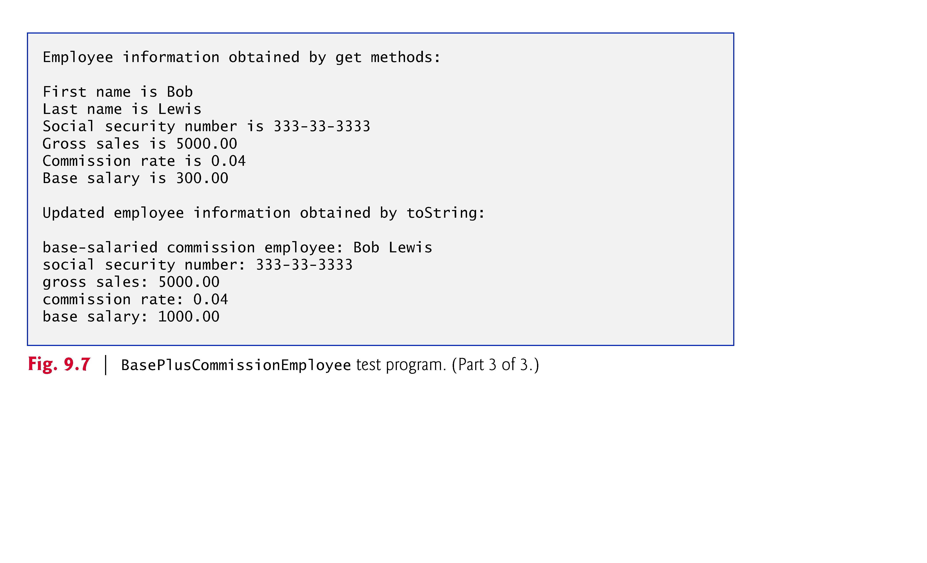

Slide 38
Case Study Part 2: Creating and Using a BasePlus-CommissionEmployee Class (Cont.)
Much of BasePlusCommissionEmployee’s code is similar, or identical, to that of CommissionEmployee.
private instance variables firstName and lastName and methods setFirstName, getFirstName, setLastName and getLastName are identical.
Both classes also contain corresponding get and set methods.
The constructors are almost identical
BasePlusCommissionEmployee’s constructor also sets the base-Salary.
The toString methods are nearly identical
BasePlusCommissionEmployee’s toString also outputs instance variable baseSalary

Slide 39
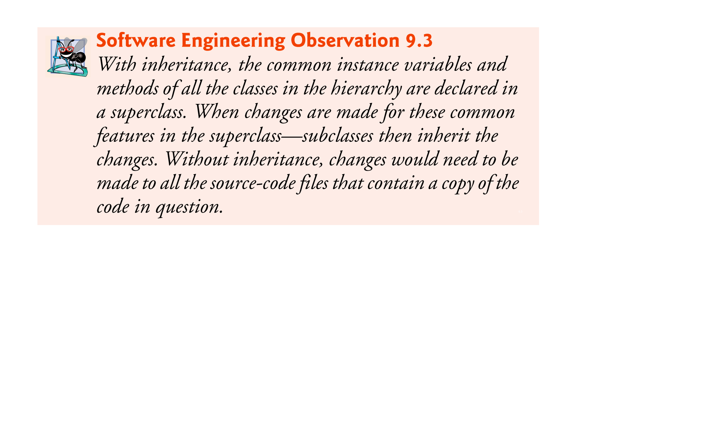
Case Study Part 2: Creating and Using a BasePlus-CommissionEmployee Class (Cont.)
We literally copied CommissionEmployee’s code, pasted it into BasePlusCommissionEmployee, then modified the new class to include a base salary and methods that manipulate the base salary.
This “copy-and-paste” approach is often error prone and time consuming.
It spreads copies of the same code throughout a system, creating a code-maintenance nightmare.

Slide 40
Case Study Part 3: Creating a CommissionEmployee–BasePlusCommissionEmployee Inheritance Hierarchy
Class BasePlusCommissionEmployee class extends class CommissionEmployee
A BasePlusCommissionEmployee object is a CommissionEmployee
Inheritance passes on class CommissionEmployee’s capabilities.
Class BasePlusCommissionEmployee also has instance variable baseSalary.
Subclass BasePlusCommissionEmployee inherits CommissionEmployee’s instance variables and methods
Only the superclass’s public and protected members are directly accessible in the subclass.

Slide 41
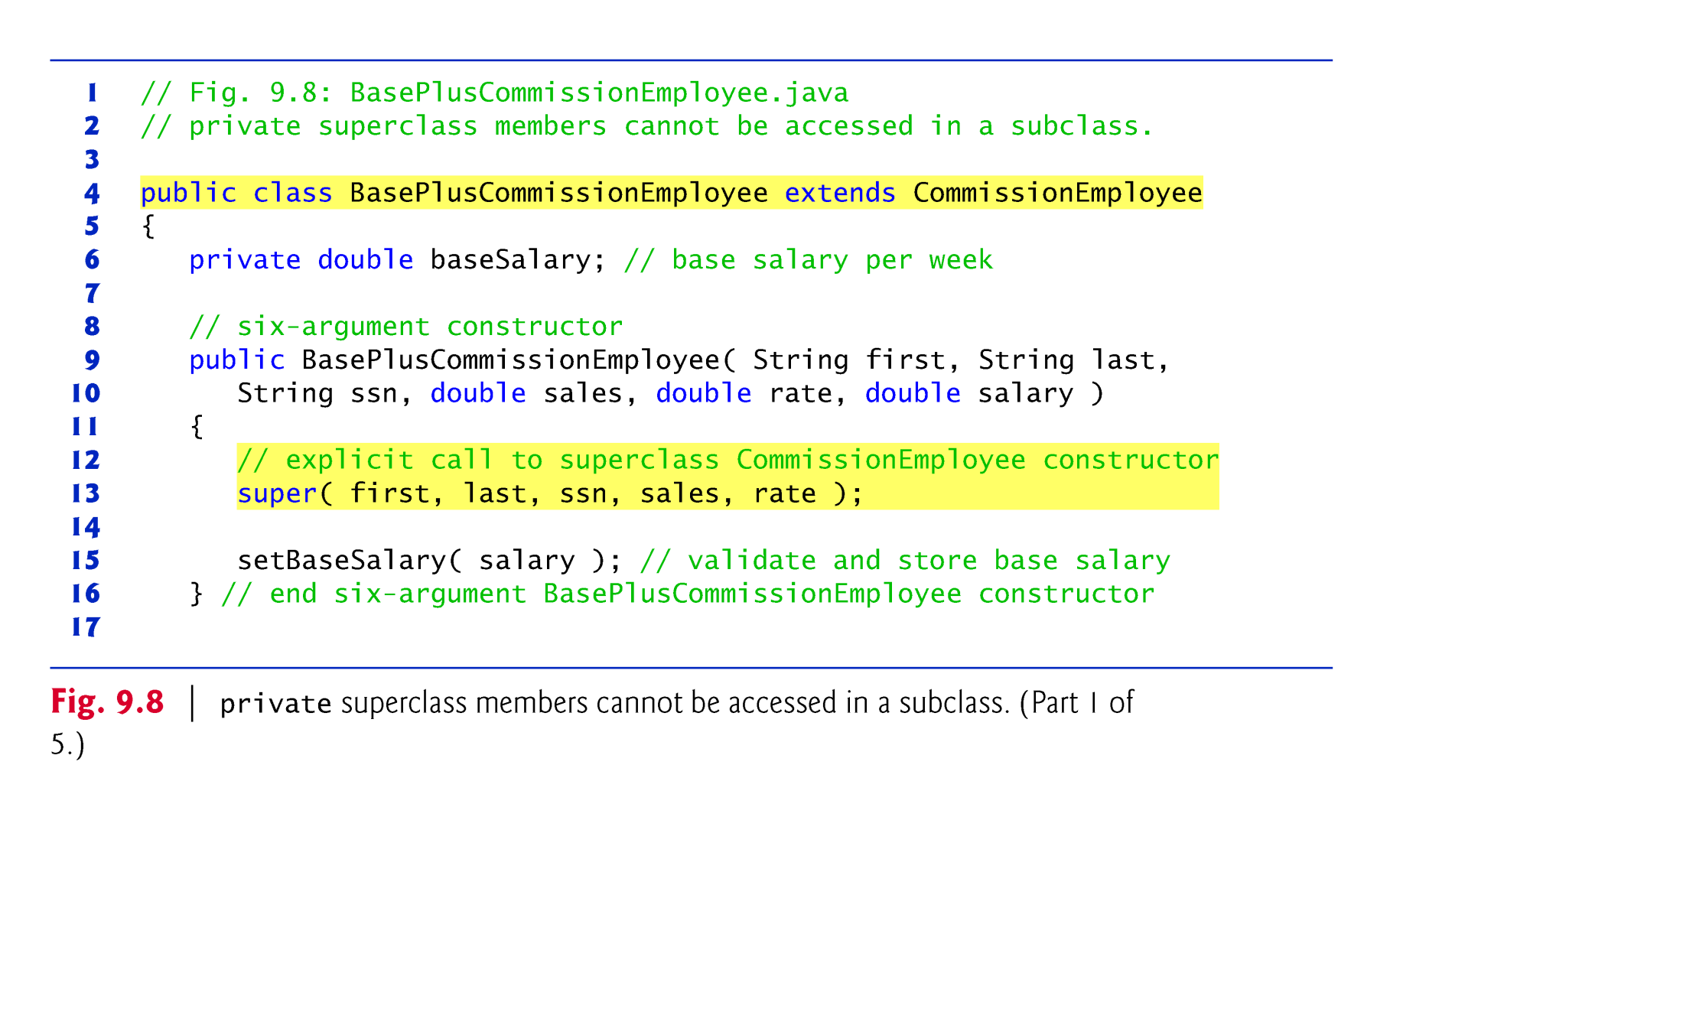

Slide 42
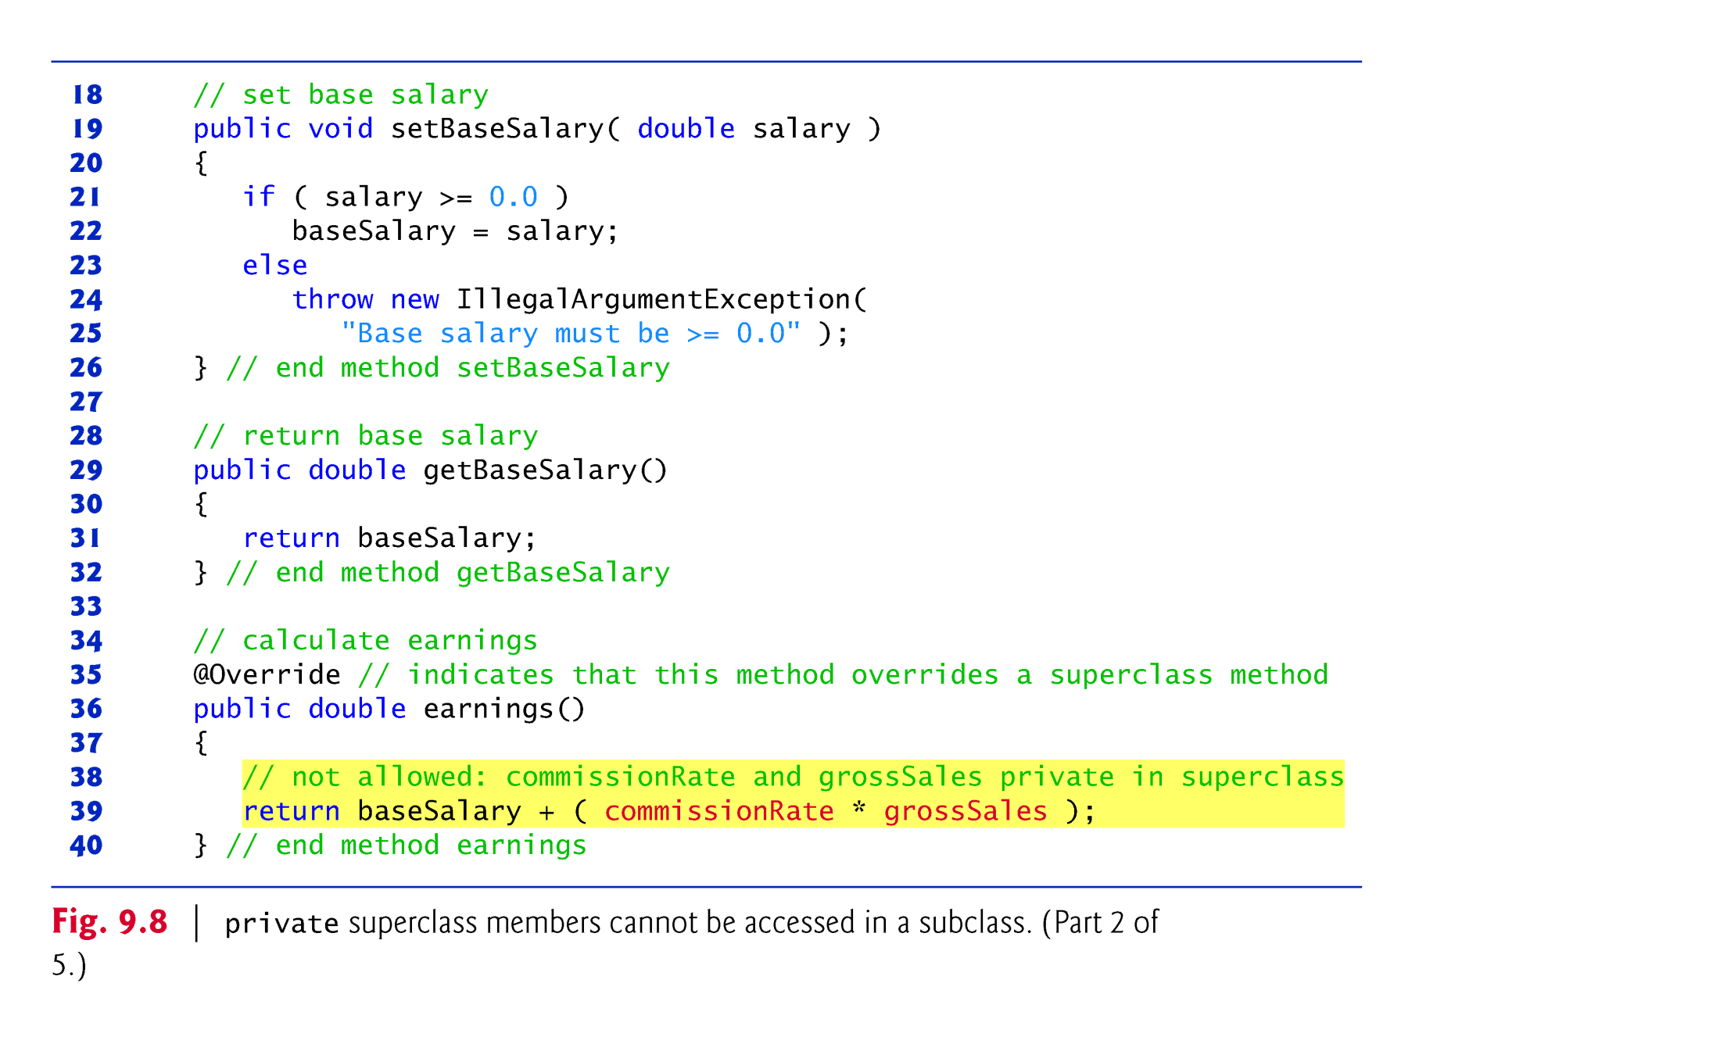

Slide 43
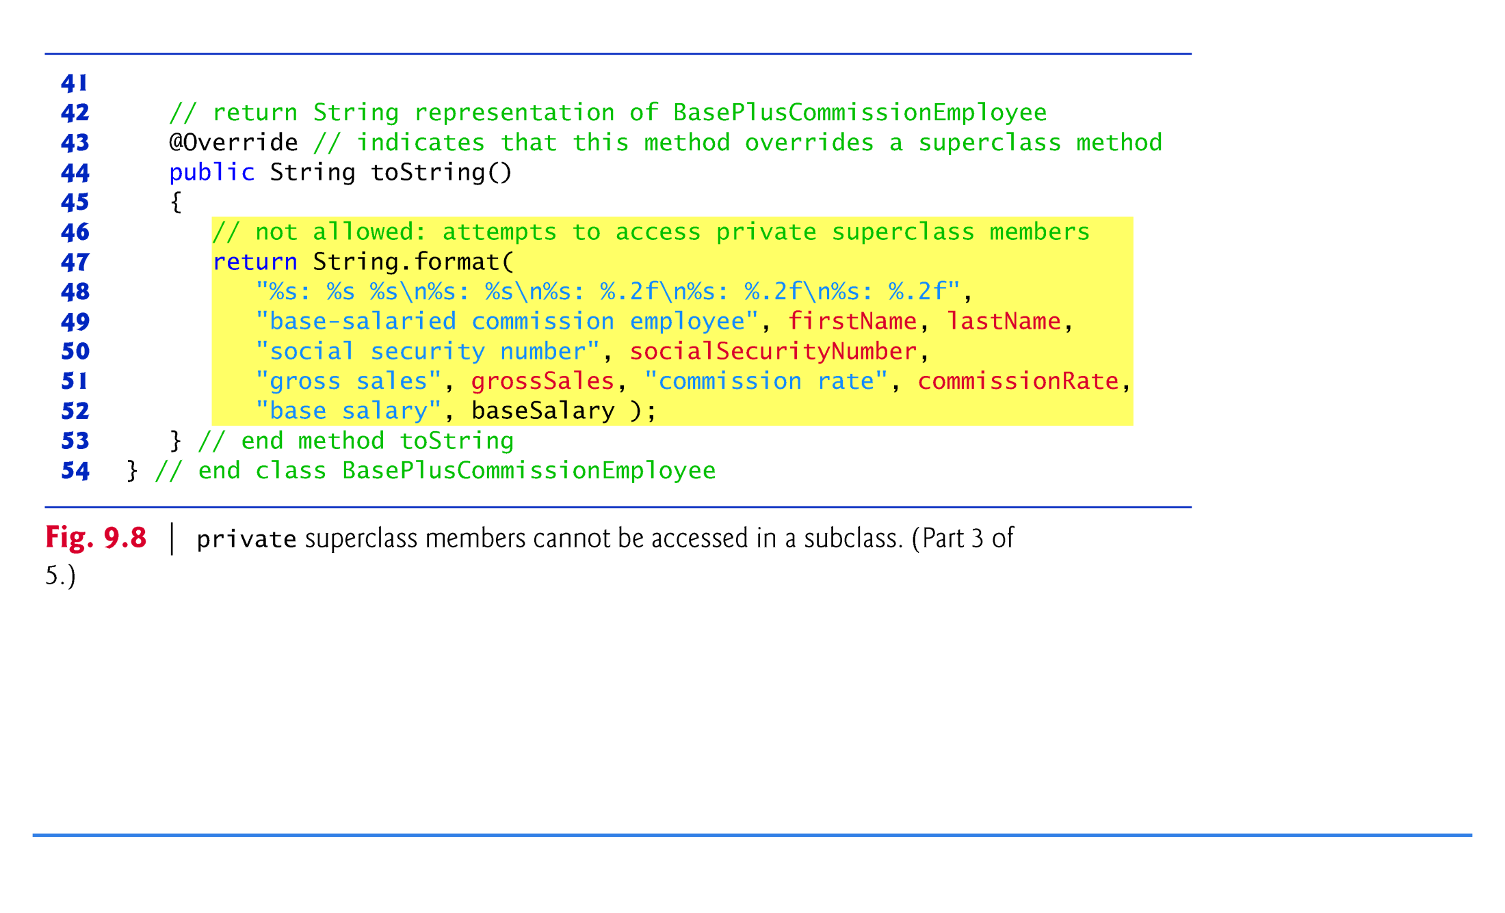

Slide 44
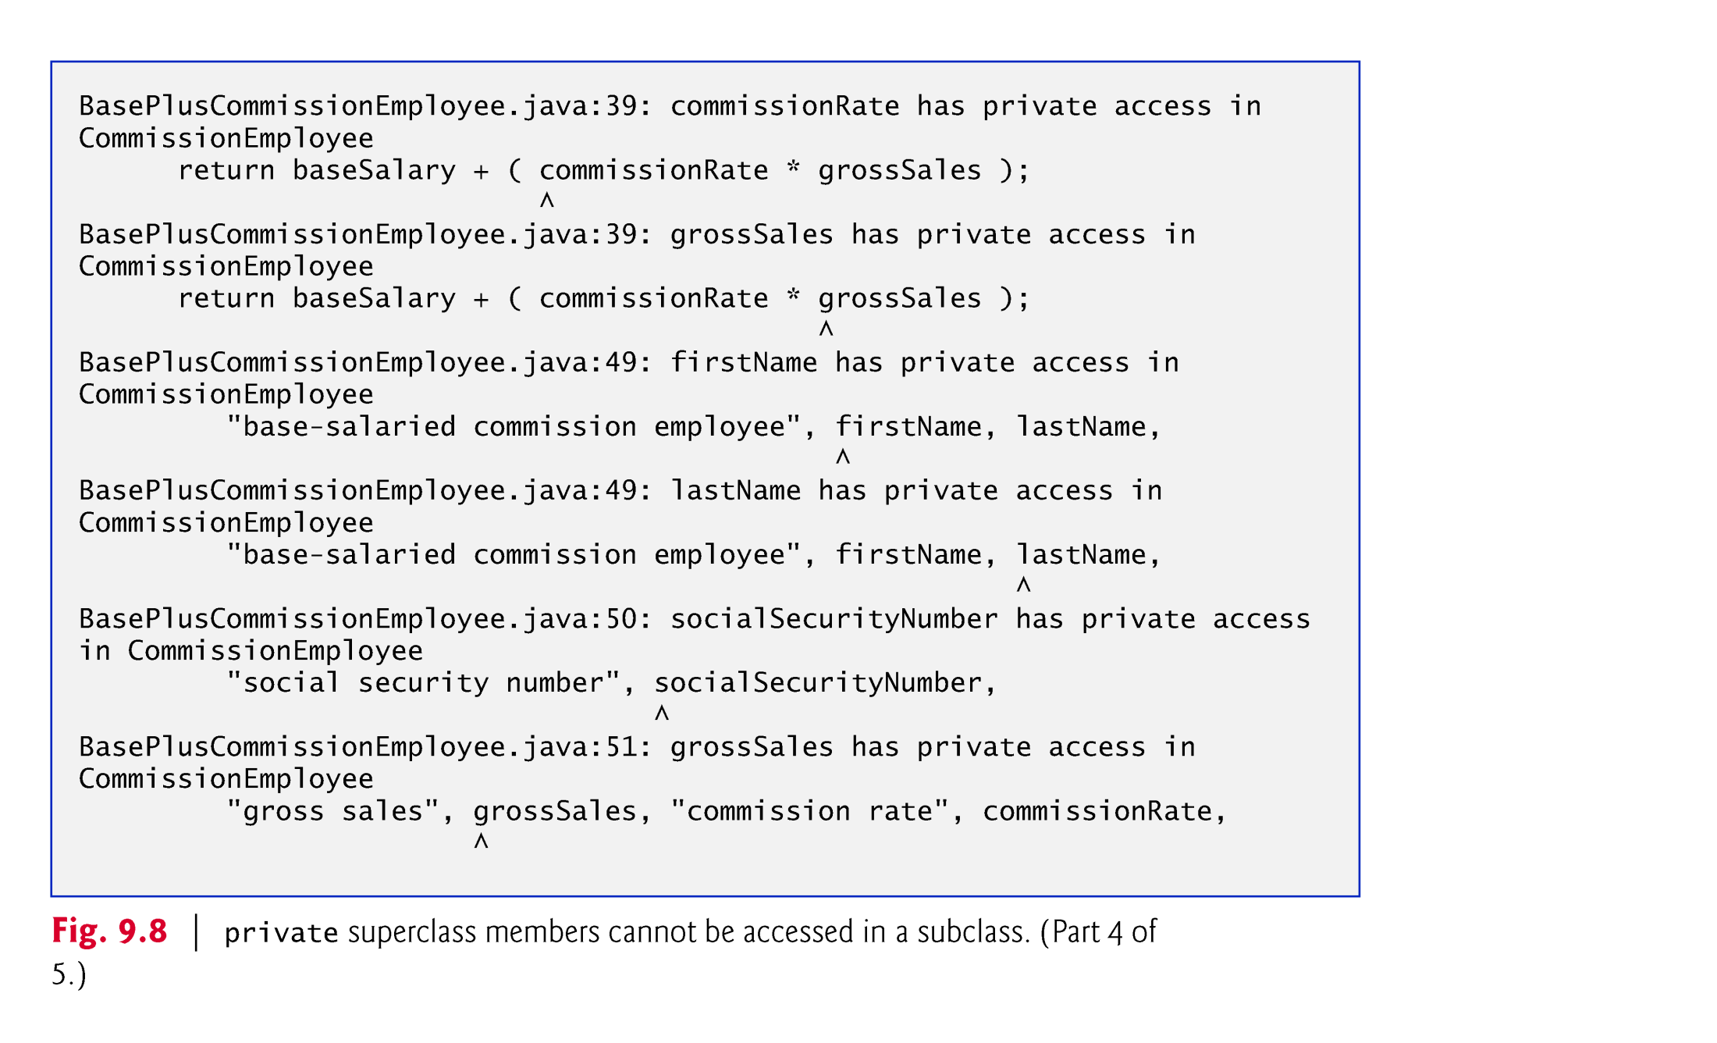

Slide 45
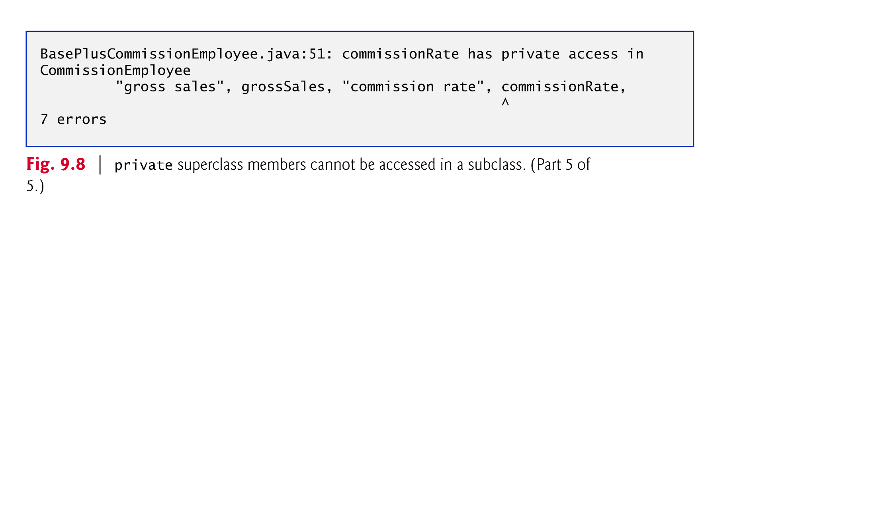

Slide 46
Case Study Part 3: Creating a CommissionEmployee–BasePlusCommissionEmployee Inheritance Hierarchy (Cont.)
Each subclass constructor must implicitly or explicitly call its superclass constructor to initialize the instance variables inherited from the superclass.
Superclass constructor call syntax—keyword super, followed by a set of parentheses containing the superclass constructor arguments.
Must be the first statement in the subclass constructor’s body.
If the subclass constructor did not invoke the superclass’s constructor explicitly, Java would attempt to invoke the superclass’s no-argument or default constructor.
Class CommissionEmployee does not have such a constructor, so the compiler would issue an error.
You can explicitly use super() to call the superclass’s no-argument or default constructor, but this is rarely done.

Slide 47
Case Study Part 4: CommissionEmployee–BasePlusCommissionEmployee Inheritance Hierarchy Using protected Instance Variables
To enable a subclass to directly access superclass instance variables, we can declare those members as protected in the superclass.
New CommissionEmployee class modified only lines 6–10 of Fig. 9.4 as follows:
protected String firstName; protected String lastName; protected String socialSecurityNumber; protected double grossSales; protected double commissionRate;
With protected instance variables, the subclass gets access to the instance variables, but classes that are not subclasses and classes that are not in the same package cannot access these variables directly.

Slide 48
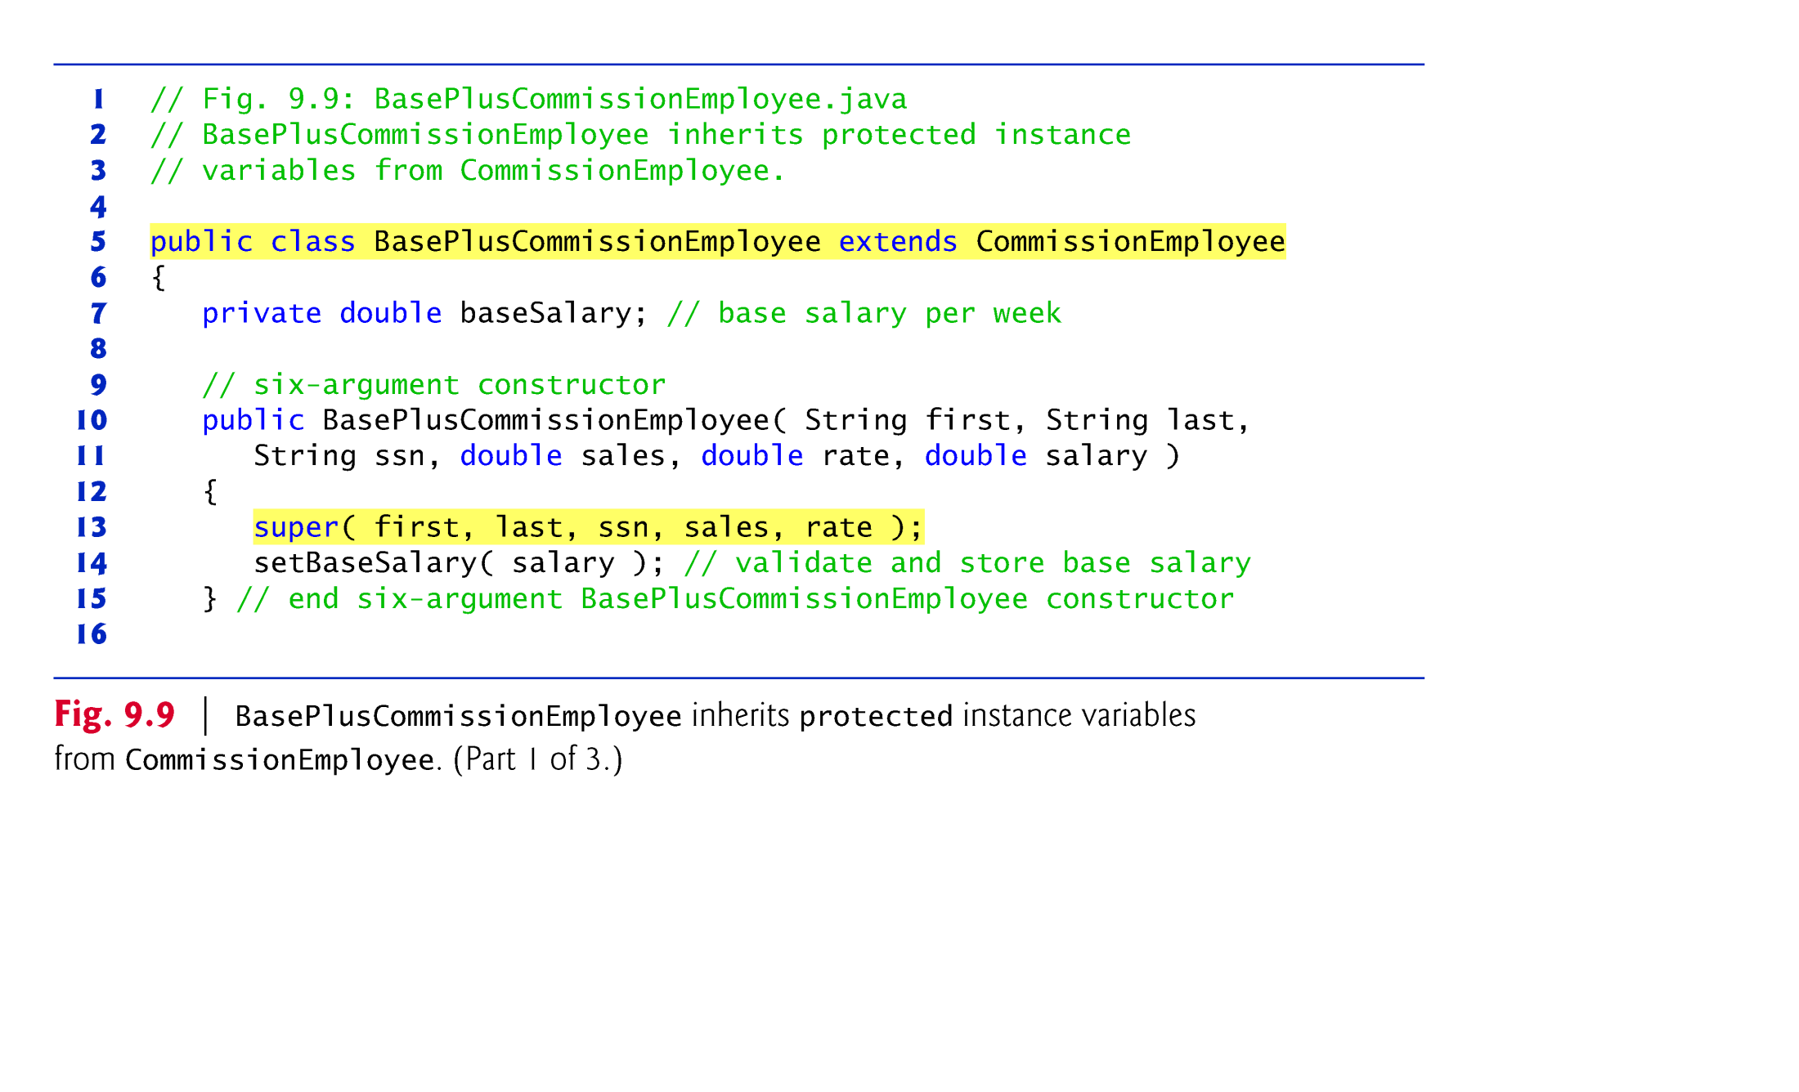

Slide 49
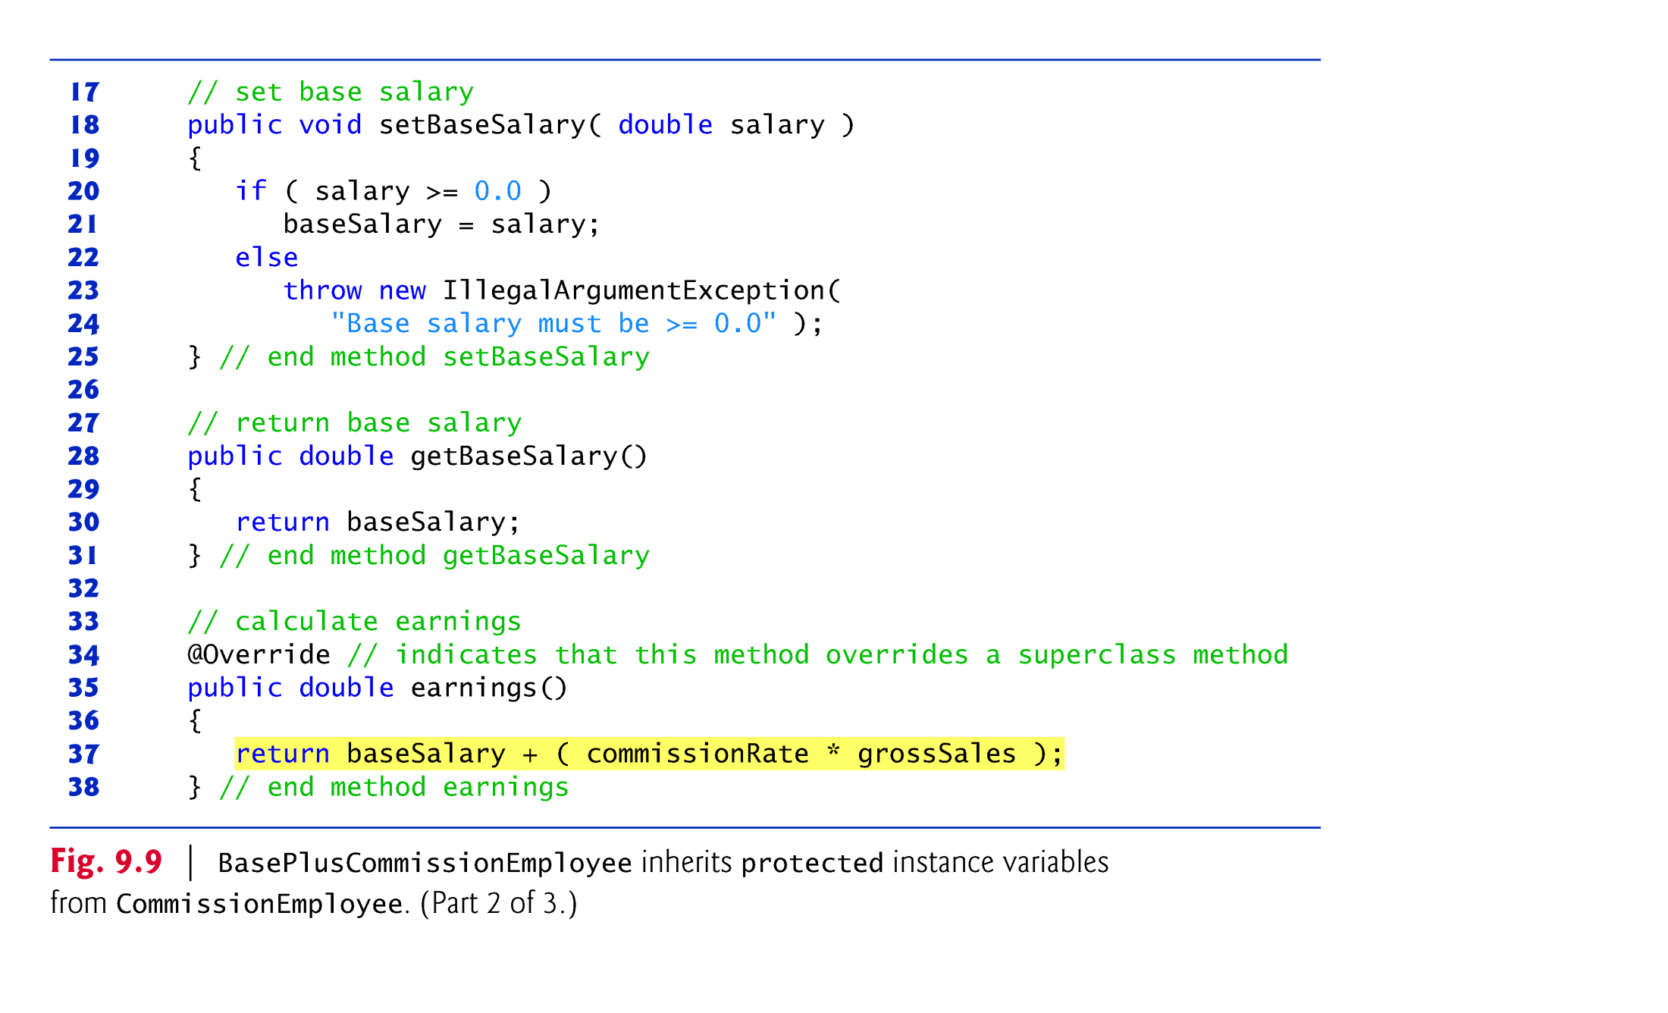

Slide 50
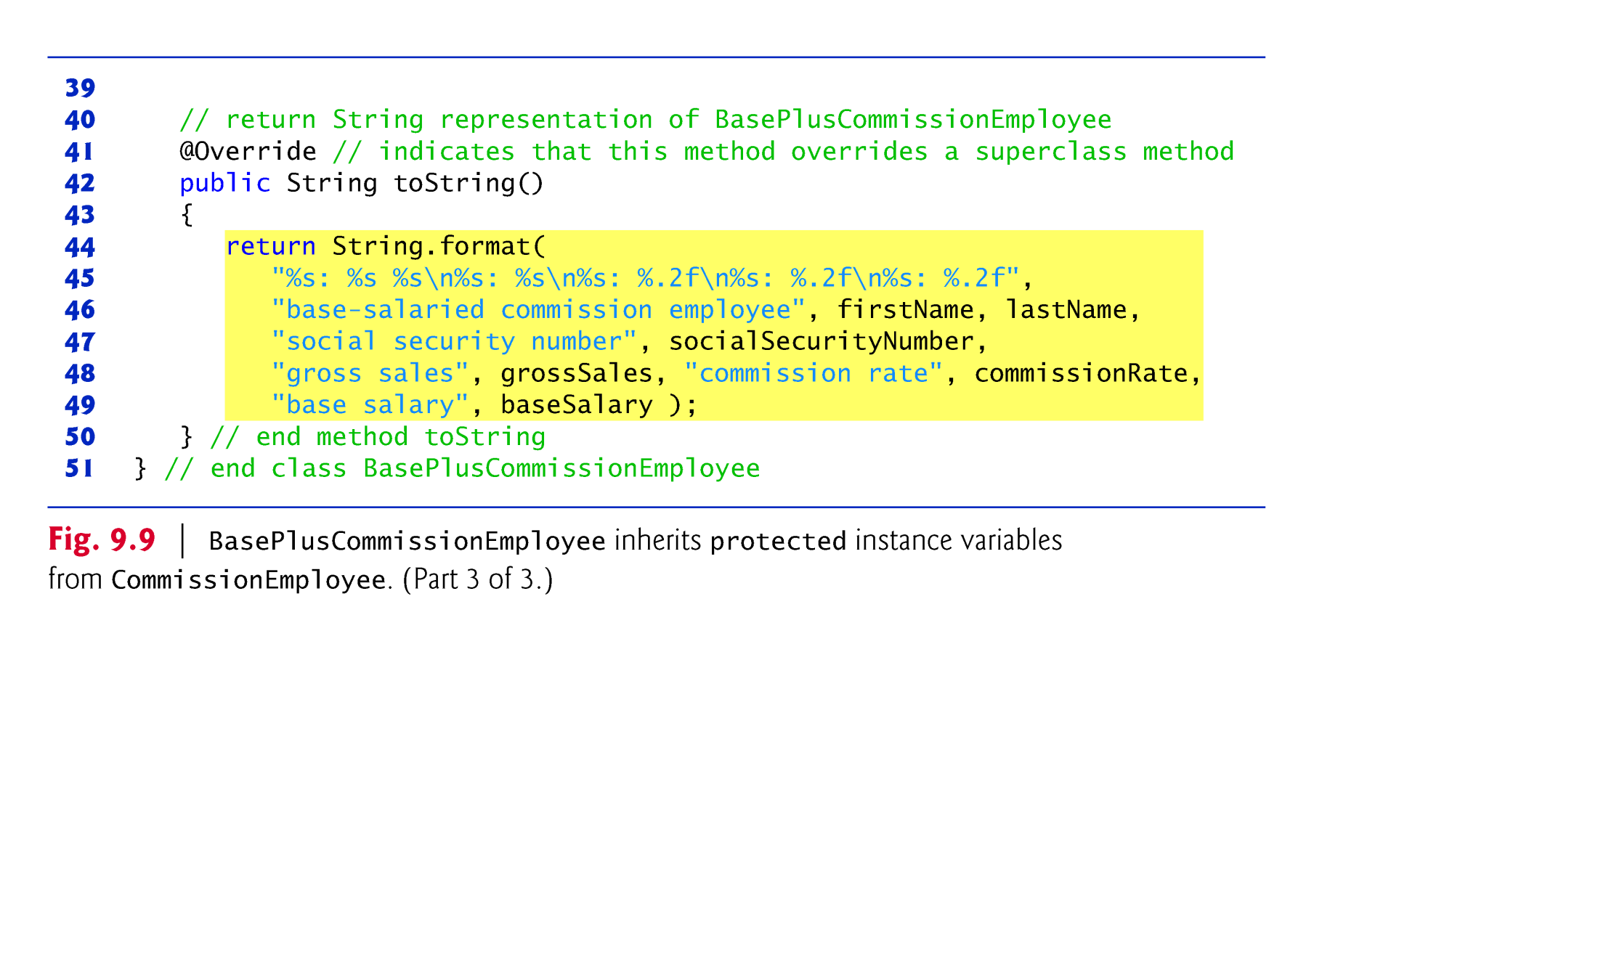

Slide 51
Case Study Part 4: CommissionEmployee–BasePlus-CommissionEmployee Inheritance Hierarchy Using protected Instance Variables (Cont.)
Class BasePlusCommissionEmployee (Fig. 9.9) extends the new version of class CommissionEmployee with protected instance variables.
These variables are now protected members of BasePlusCommissionEmployee.
If another class extends this version of class BasePlusCommissionEmployee, the new subclass also can access the protected members.
The source code in Fig. 9.9 (51 lines) is considerably shorter than that in Fig. 9.6 (128 lines)
Most of the functionality is now inherited from CommissionEmployee
There is now only one copy of the functionality.
Code is easier to maintain, modify and debug—the code related to a commission employee exists only in class CommissionEmployee.

Slide 52
Case Study Part 4: CommissionEmployee–BasePlus-CommissionEmployee Inheritance Hierarchy Using protected Instance Variables (Cont.)
Inheriting protected instance variables slightly increases performance, because we can directly access the variables in the subclass without incurring the overhead of a set or get method call.
In most cases, it’s better to use private instance variables to encourage proper software engineering, and leave code optimization issues to the compiler.
Code will be easier to maintain, modify and debug.

Slide 53
Case Study Part 4: CommissionEmployee–BasePlus-CommissionEmployee Inheritance Hierarchy Using protected Instance Variables (Cont.)
Using protected instance variables creates several potential problems.
The subclass object can set an inherited variable’s value directly without using a set method.
A subclass object can assign an invalid value to the variable
Subclass methods are more likely to be written so that they depend on the superclass’s data implementation.
Subclasses should depend only on the superclass services and not on the superclass data implementation.
We may need to modify all the subclasses of the superclass if the superclass implementation changes.
You should be able to change the superclass implementation while still providing the same services to the subclasses.

Slide 54
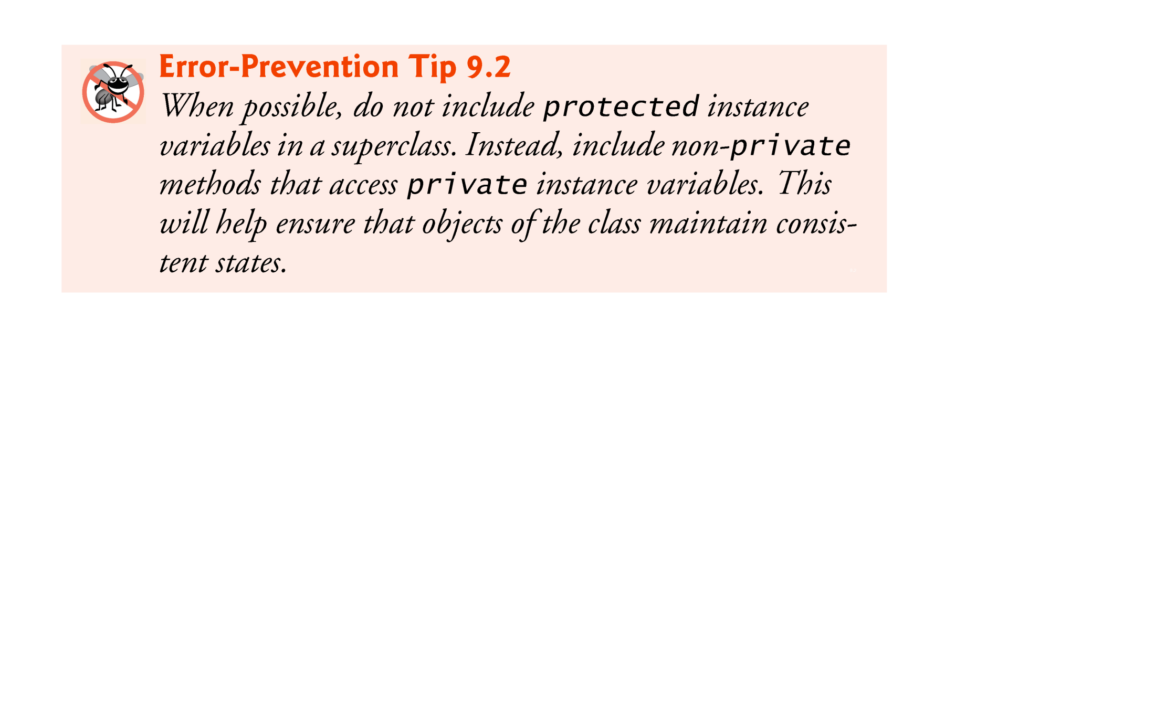

Slide 55
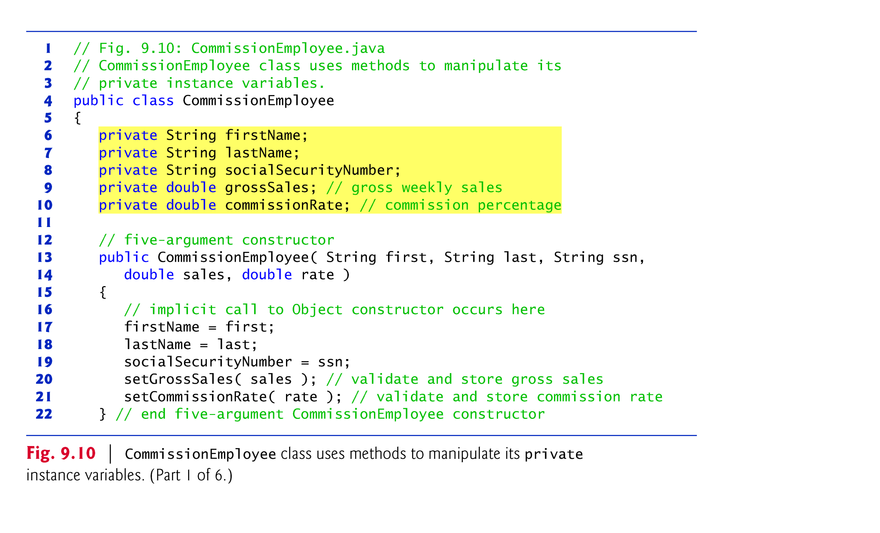
Case Study Part 5: CommissionEmployee–BasePlus-CommissionEmployee Inheritance Hierarchy Using private Instance Variables => BEST DESIGN
instance variables are declared as private and public methods for manipulating these are provided.

Slide 56
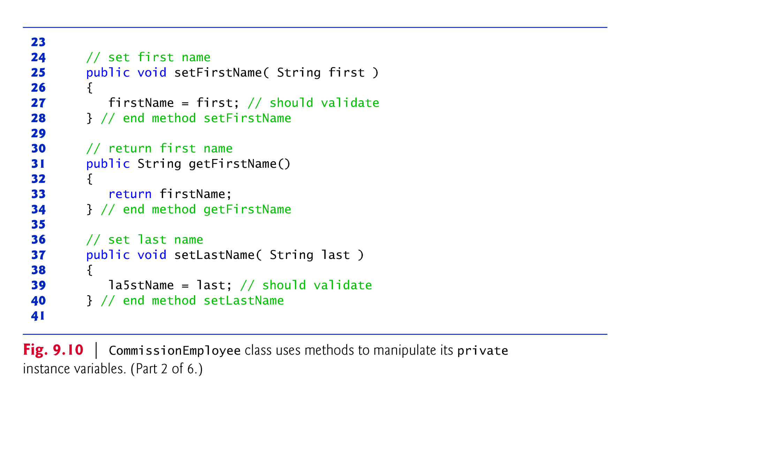

Slide 57


Slide 58
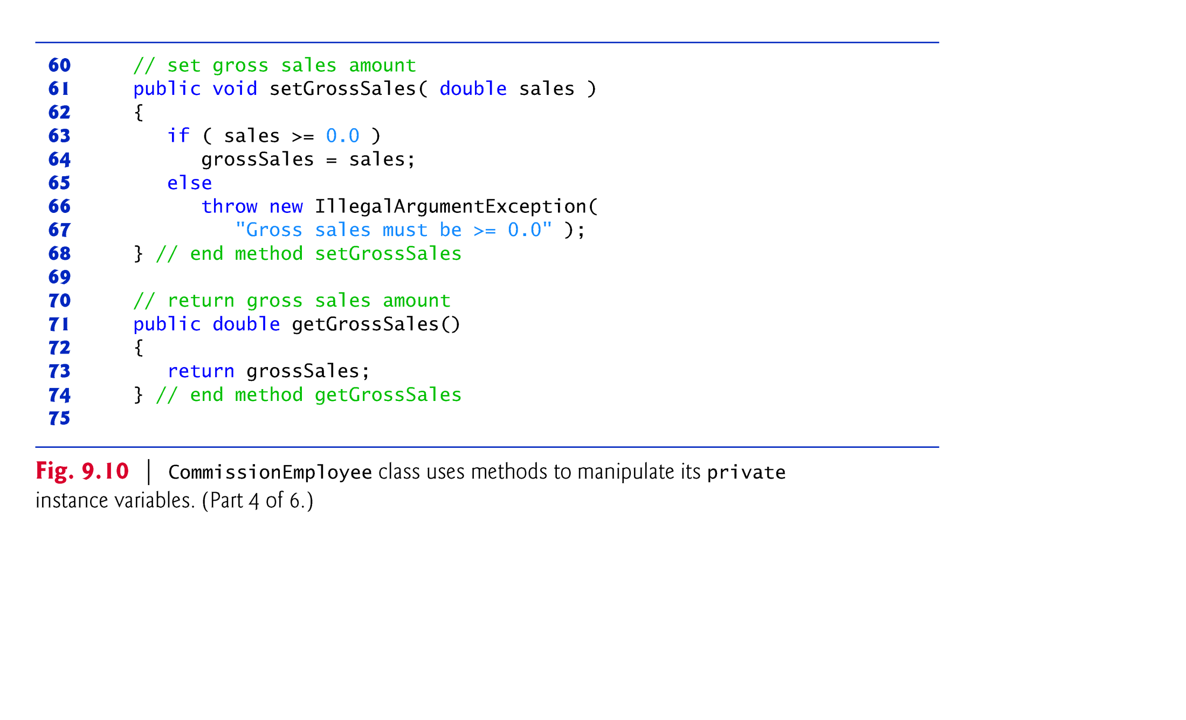

Slide 59
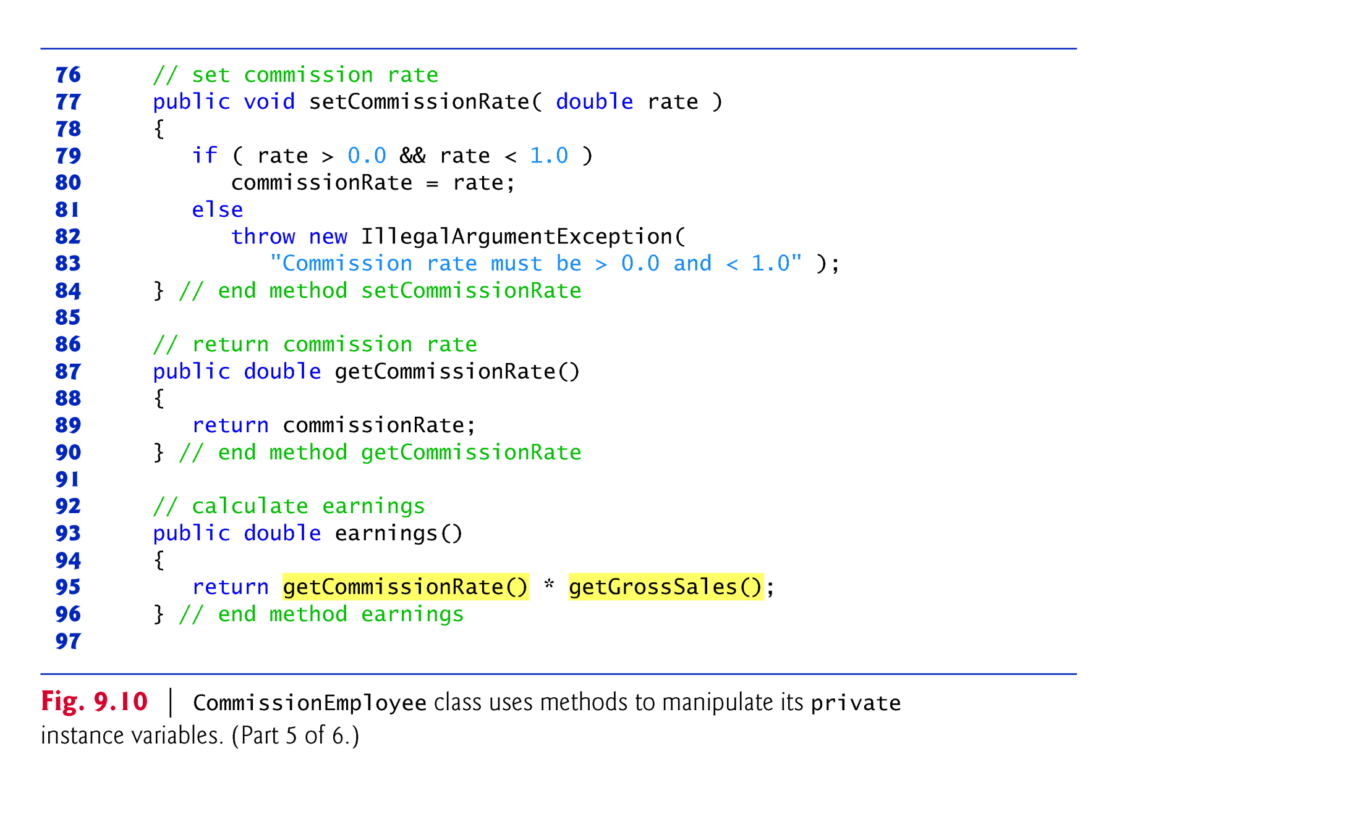

Slide 60
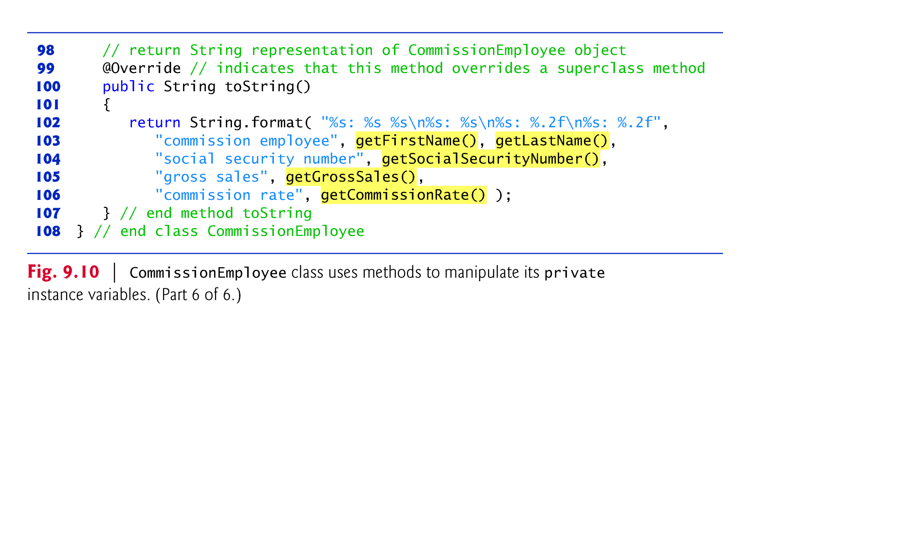

Slide 61
Case Study Part 5: CommissionEmployee–BasePlus-CommissionEmployee Inheritance Hierarchy Using private Instance Variables (Cont.)
CommissionEmployee methods earnings and toString use the class’s get methods to obtain the values of its instance variables.
If we decide to change the internal representation of the data (e.g., variable names) only the bodies of the get and set methods that directly manipulate the instance variables will need to change.
These changes occur solely within the superclass-—no changes to the subclass are needed.
Localizing the effects of changes like this is a good software engineering practice.
Subclass BasePlusCommissionEmployee inherits CommissionEmployee’s non-private methods and can access the private superclass members via those methods.

Slide 62
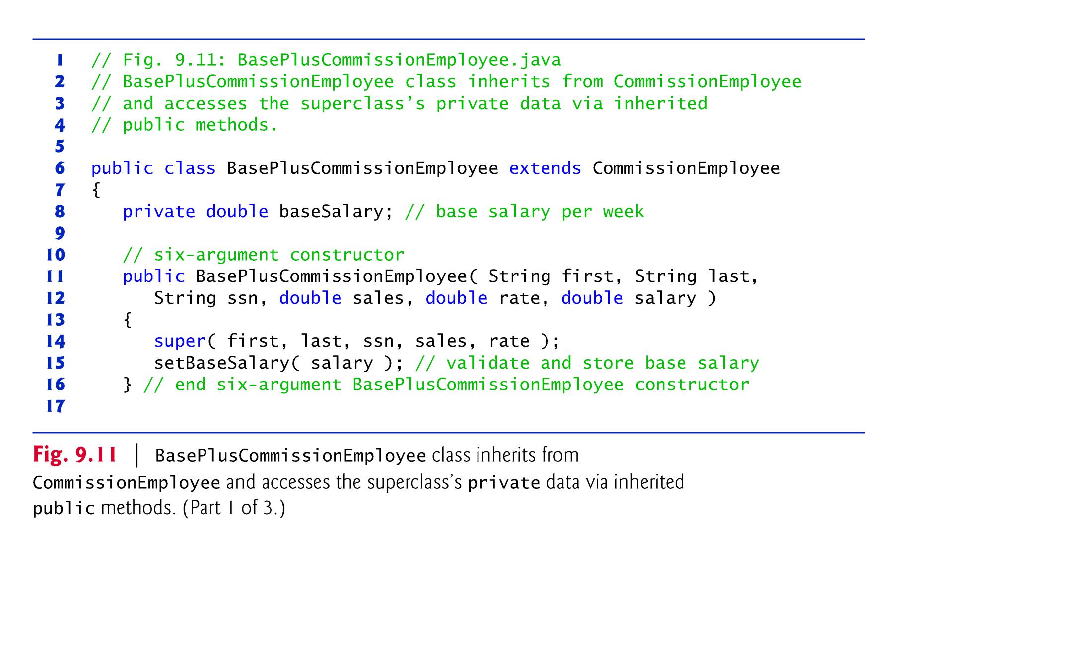
Case Study Part 5: CommissionEmployee–BasePlus-CommissionEmployee Inheritance Hierarchy Using private Instance Variables (Cont.)

Slide 63
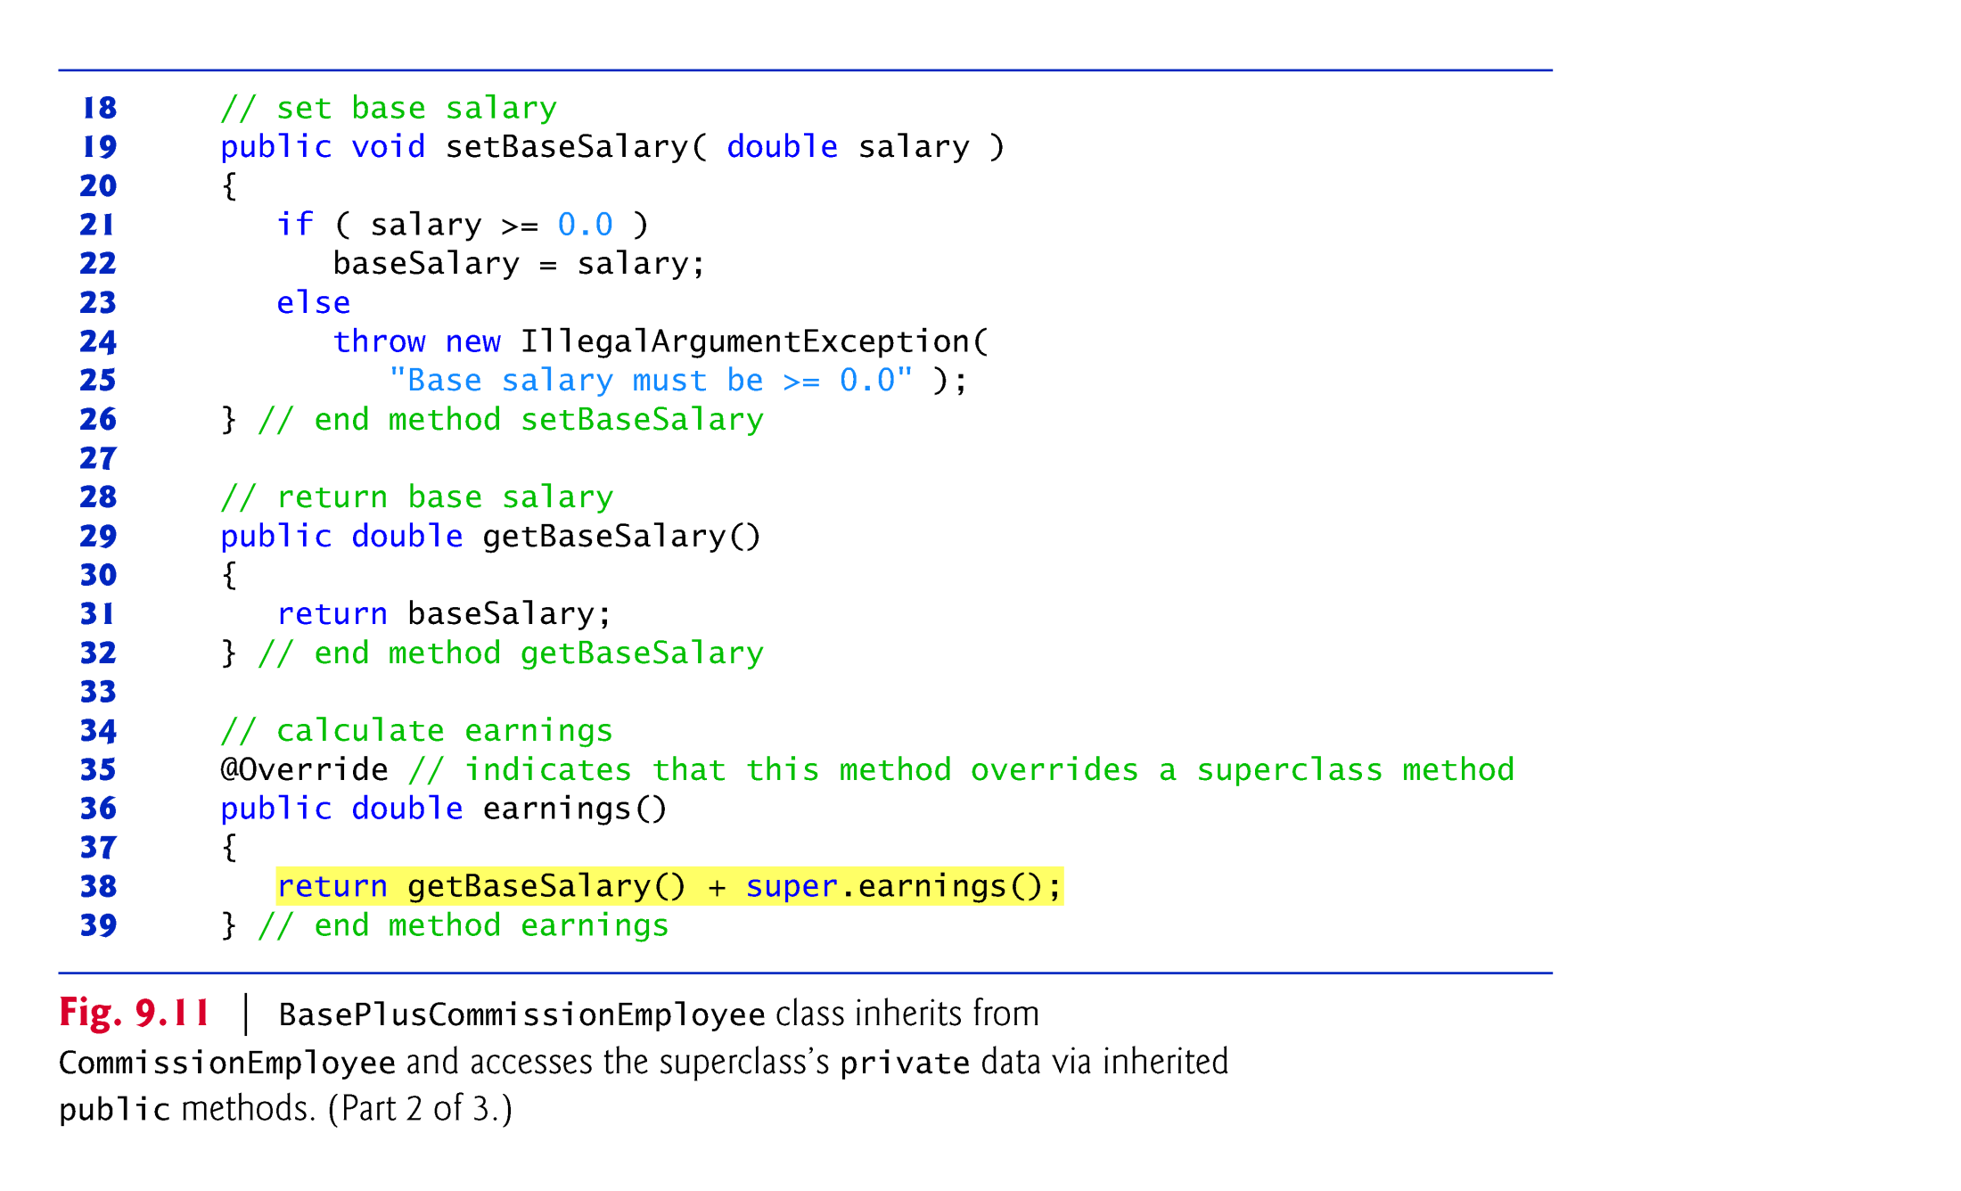
Method earnings overrides class the superclass’s earnings method.
calls CommissionEmployee’s earnings method with super.earnings()
Good software engineering practice: If a method performs all or some of the actions needed by another method, call that method rather than duplicate its code.

Slide 64
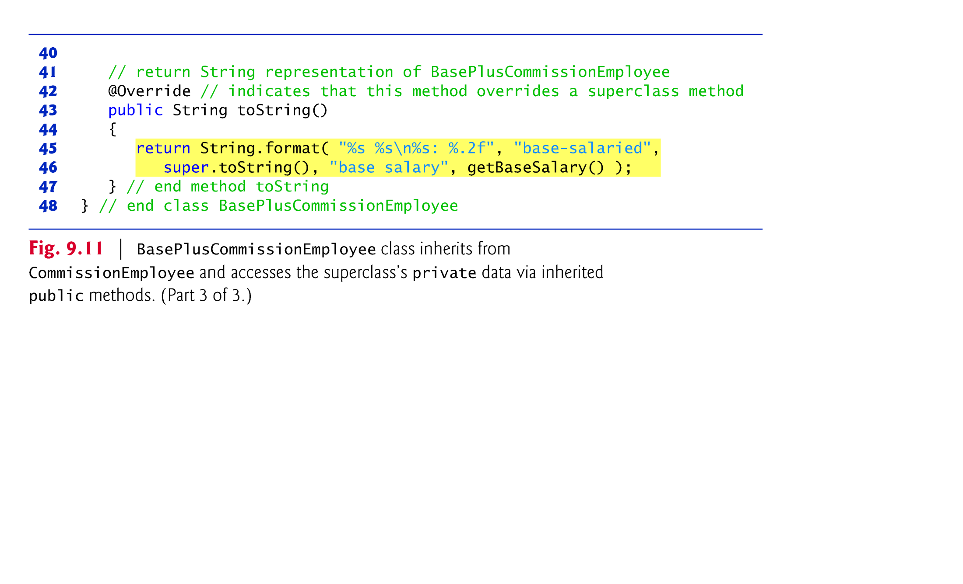
BasePlusCommissionEmployee’s toString method overrides class CommissionEmployee’s toString method
The new version creates part of the String representation by calling CommissionEmployee’s toString method with the expression super.toString().

Slide 65
Constructors in Subclasses
Instantiating a subclass object begins a chain of constructor calls
The subclass constructor, before performing its own tasks, invokes its direct superclass’s constructor
If the superclass is derived from another class, the superclass constructor invokes the constructor of the next class up the hierarchy, and so on.
The last constructor called in the chain is always class Object’s constructor.
Original subclass constructor’s body finishes executing last.
Each superclass’s constructor manipulates the superclass instance variables that the subclass object inherits.

Slide 66
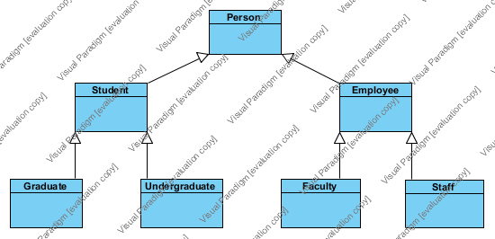
UML Inheritance Diagrams
A class hierarchy in UML notation
An Employee is a Person and so forth; hence the arrows point up.

Slide 67
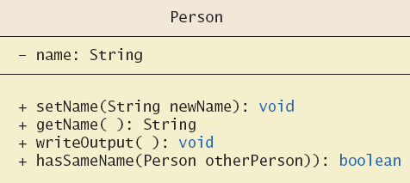
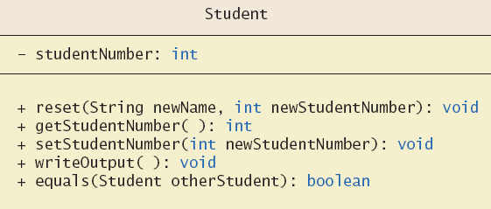
UML Inheritance Diagrams
Some details of UML class hierarchy from previous figure

Slide 68
Acknowledgments
The course material used to prepare this presentation is mostly taken/adopted from the list below:
Java - How to Program, Paul Deitel and Harvey Deitel, Prentice Hall, 2012
Java - An Introduction to Problem Solving and Programming, Walter Savitch, Pearson, 2012

